Slide 1
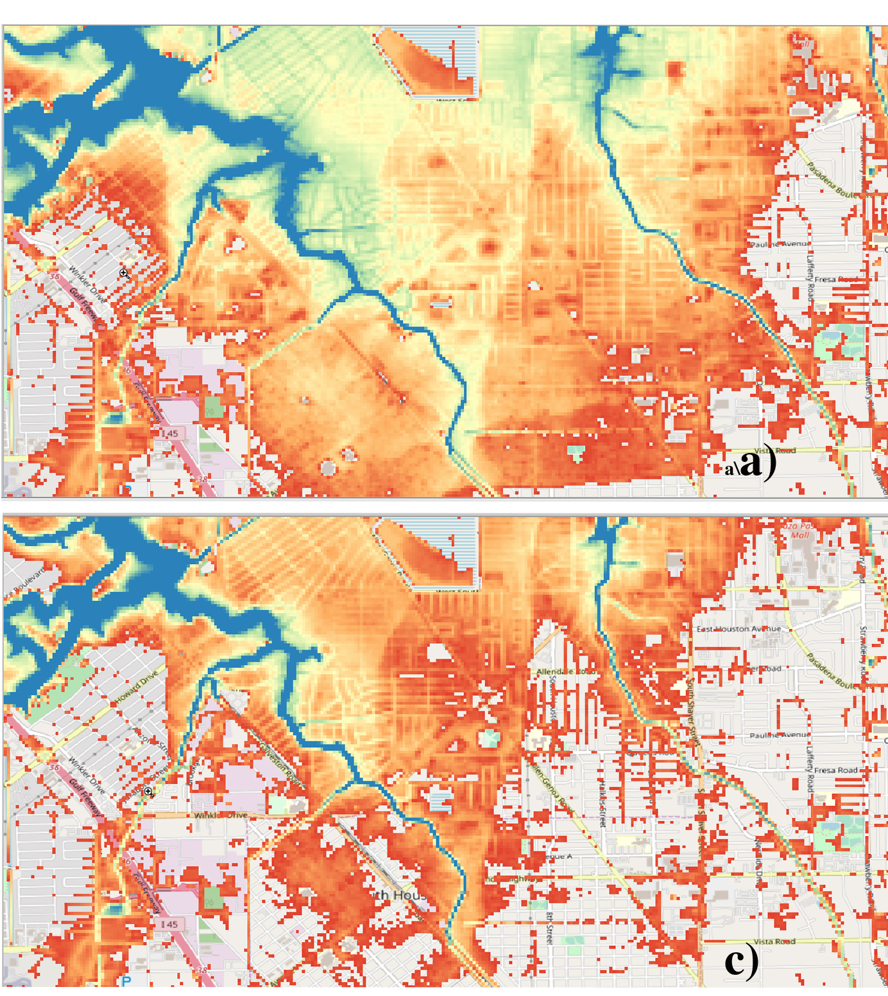

Attributing Extreme Weather:
The New Science of Extreme Event Attribution
While March 14 (3/14) is celebrated by many by eating pie, few may know that it is also the “International Day of Mathematics”. The United Nations Educational, Scientific and Cultural Organization (UNESCO) solicited a brief for their book “Mathematics for action: supporting science-based decision-making”. They released this book on March 14, 2022 covering a wide variety of topics. In my contribution, I described how the attribution of the human influence on extreme weather and the climate is an exercise in statistical causal inference. I emphasized that confidence in resulting attribution statements is enhanced when multiple methods, mathematical models, and data sources lead to similar conclusions using Hurricane Harvey as an example.
The UNESCO book is primarily targeted towards mathematics teachers. By presenting practical applications of higher math and statistics, these selected “briefs” are intended to show the relevance of mathematics to students.
Top: Simulation of the depth of the actual Hurricane Harvey flood in the South Houston neighborhood. Bottom: Simulation of the counterfactual Hurricane Harvey flood without the current amount of climate change.
  Extreme event attribution is presented to students and educators as a practical example of mathematics in a recent UNESCO book. Emphasis is placed on how confidence is enhanced through multiple rigorous statistical analyses.
Citation: Michael F. Wehner (2022) Attributing Extreme Weather: The New Science of Extreme Event Attribution. In Mathematics for action: supporting science-based decision-making. Jean-Stéphane Dhersin, Hans Kaper, Wilfred Ndifon, Fred Roberts, Christiane Rousseau, Günter M Ziegler, editors. UNESCO, pp 37-38 ISBN 978-92-3-100517-6
https://unesdoc.unesco.org/ark:/48223/pf0000380883.locale=en

