Slide 1
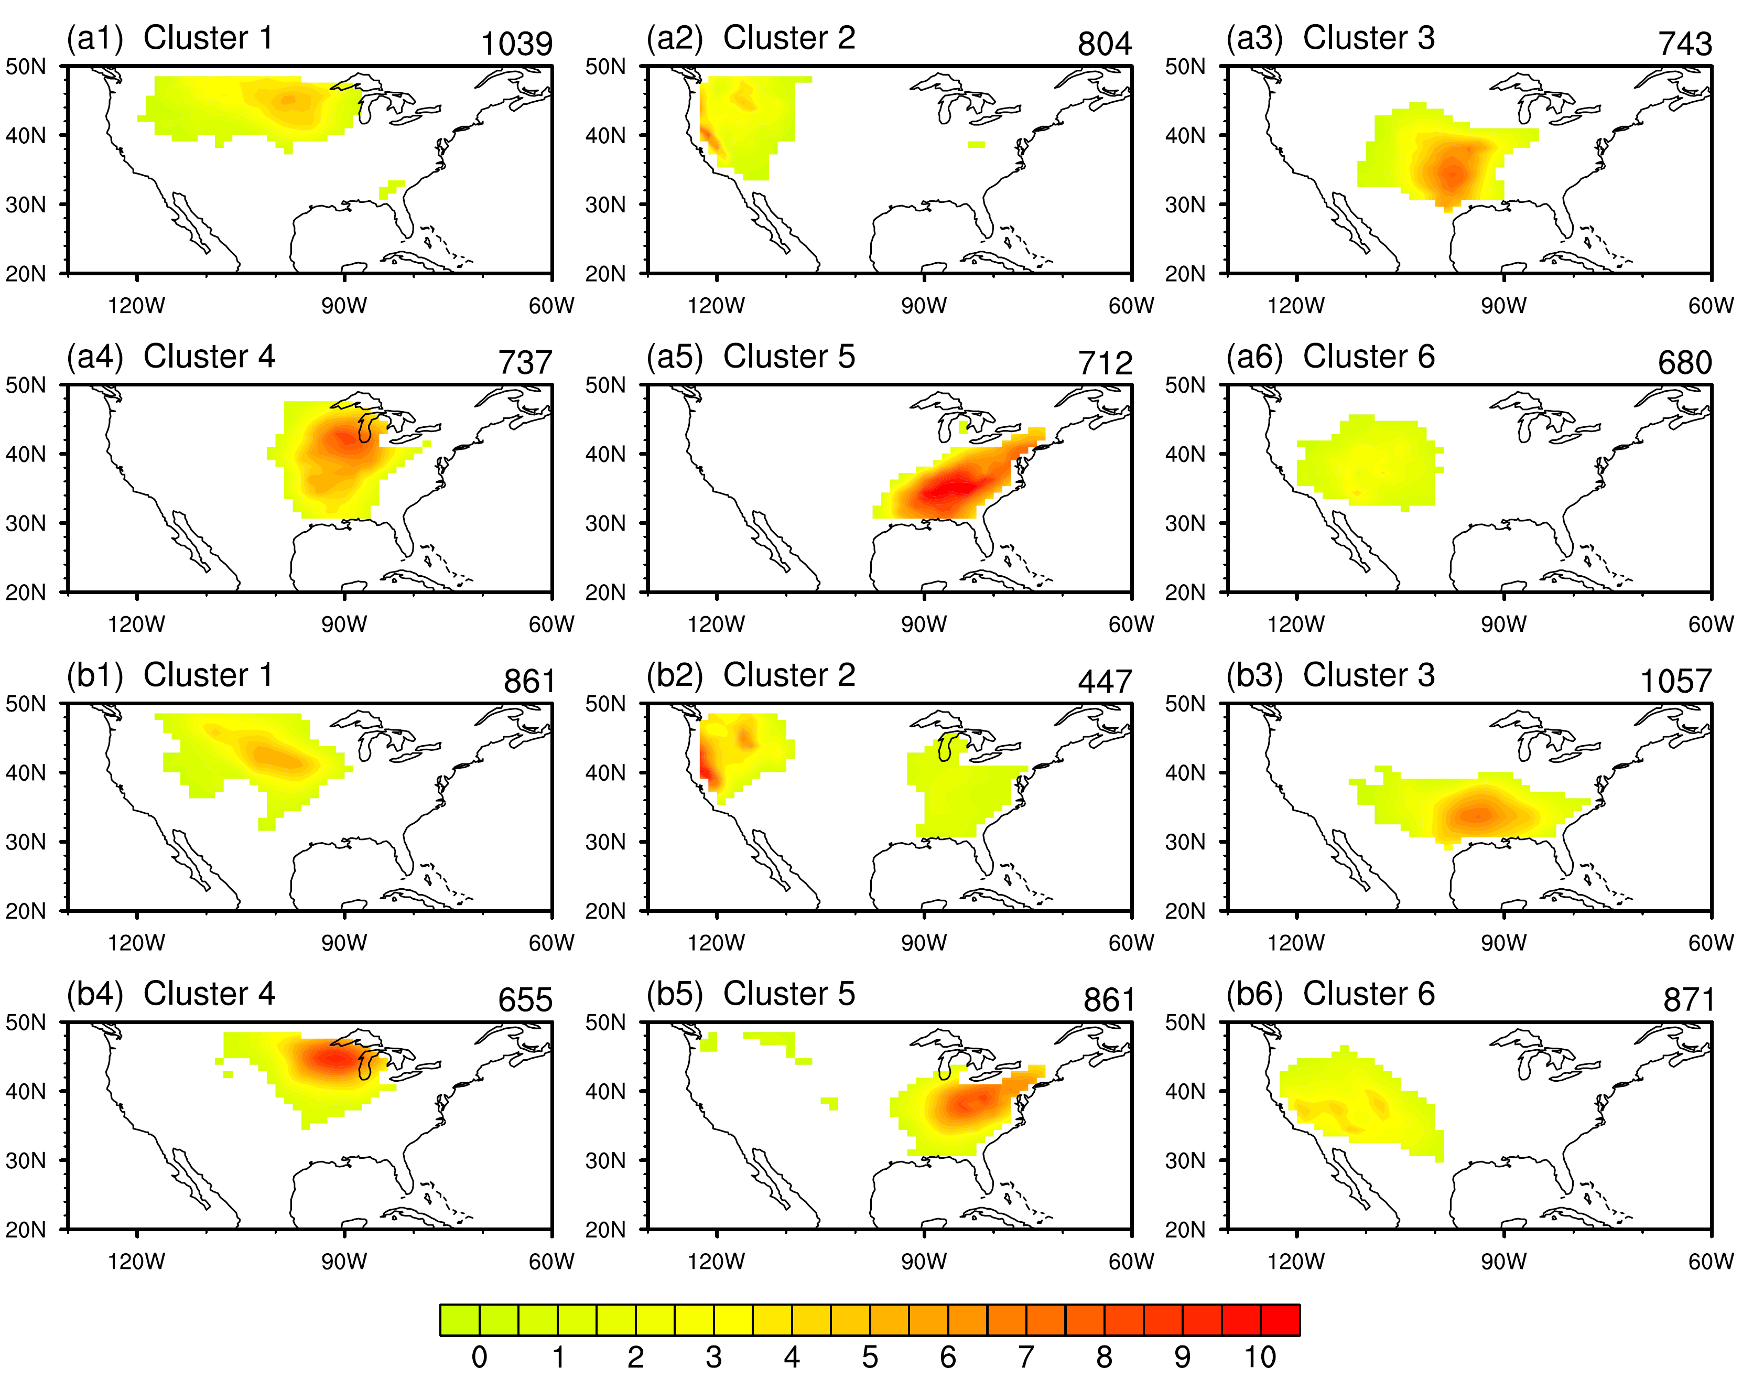
A Dynamical and Statistical Characterization of United States Extreme Precipitation Events and their Associated Large-Scale Meteorological Patterns
Objective: The study objectively delineates (in both observations and CCSM4) the fundamental extreme precipitation patterns (EPPs) occurring in the continental US along with the large-scale meteorological patterns (LMPs) that drive them.
Research: A hierarchical cluster analysis of daily precipitation is used to isolate canonical EPPs for the boreal warm and cool seasons in observations and a parallel historical simulation of the CCSM4 for the period 1950-2005. The LMP that induces each of the observed EPPs is isolated and used as a fundamental basis function for testing a climate model’s potential for properly simulating patterns of precipitation extremes. Parallel statistical and synoptic analyses of both observed and simulated EPPs and LMPs are carried out in our study.
Composite precipitation anomalies (mm/day) for 6 warm season extreme precipitation clusters for observations (a1-a6) and the CCSM4 (b1-b6). Occurrence frequency (days) is plotted in the upper right of each panel.
Impact: The utility of the LMP methodology in characterizing the synoptic and dynamic nature of extreme events is demonstrated. Model skill in representing EPP behavior details is found to be positively correlated to its ability to simulate the corresponding LMP. For example, the model bias in the occurrence frequency of a given LMP is directly related to an analogous frequency bias in the corresponding EPP induced by the LMP.
Reference: Zhao, S., Y. Deng, and R.X. Black, 2017: A Dynamical and Statistical Characterization of United States Extreme Precipitation Events and their Associated Large-Scale Meteorological Patterns, J Climate (in press).

