Slide 1
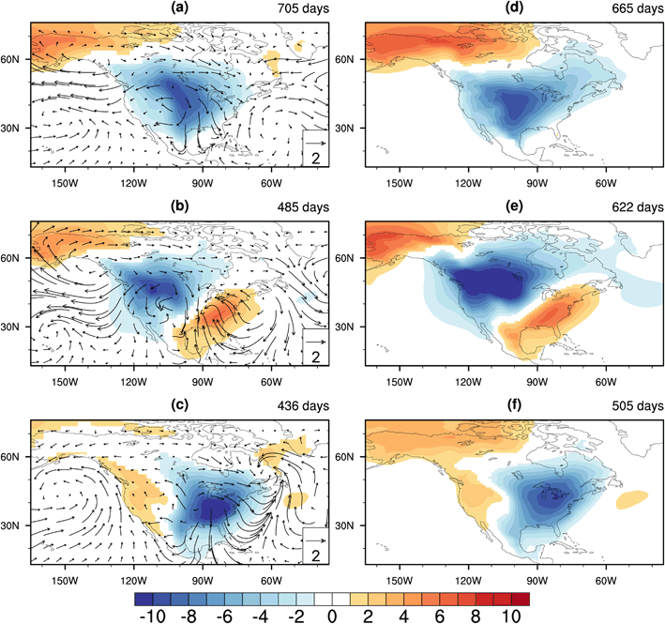
The Structure and Large-Scale Organization of Extreme Cold Waves over the Conterminous United States
Science: The study identifies three recurrent extreme cold wave (ECW) patterns that affect the upper midwest, northwest and southeast US, respectively, and assesses how each pattern is linked to the large-scale atmospheric circulation and primary modes of climate variability. The ability of modern climate models to represent ECW behavior and forcing is also tested.
Research: A hierarchical cluster analysis of daily surface air temperature is used to isolate typical ECW patterns occurring over the US during the cool season in observations and parallel CCSM4 simulations for the period 1950-2005. The large-scale meteorological pattern (LMP) that induces each ECW is identified. Extensive statistical and synoptic analyses are carried out and the model’s ability to properly simulate ECWs is established.
Composite anomalies in surface air temperature (Shaded; °C) and wind (arrows) for observed (a) upper midwest (UM), (b) northwest (NW), and (c) southeast (SE) ECWs. Panels d–f as per a–c, but for CCSM4.
ECW modulation by key climate modes (ENSO; PDO) and cryospheric perturbations is assessed.
Impact: The research provides an objective basis for understanding how and why certain extreme weather events occur. This basis provides critical metrics for assessing (a) the veracity of climate models and (b) how the behavior of such extreme weather events may vary in future decades.
Reference: Xie, Z., R.X. Black, and Y. Deng, 2017: The Structure and Large-Scale Organization of Extreme Cold Waves over the Conterminous United States, Climate Dynamics, 49, (in press).

