Slide 1
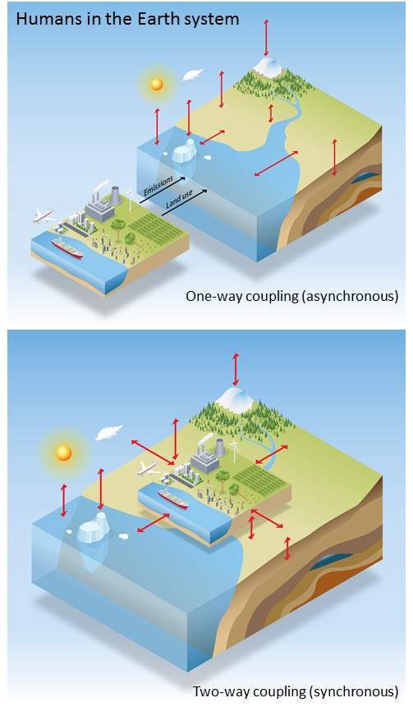
Biospheric feedback effects in a synchronously coupled model of human and Earth systems
Synchronous coupling of an Earth system model with an energy-economics model eliminates important sources of climate and human system prediction uncertainty
Objective | Identify and quantify inconsistencies associated with asynchronous, one-way coupling of human and Earth system models, and eliminate those inconsistencies by designing and implementing a synchronous two-way coupled model of human and Earth system processes.
New science | By passing information on biospheric processes from the Earth system model to the human system model, impacts of climate change are allowed to influence the energy-economic systems. Higher CO₂ concentrations lead to increased vegetation productivity, higher crop yields (including biomass energy crops), lower crop prices, and reduced conversion of forest to cropland.
Significance | Feedbacks in the energy system lead to reduced fossil fuel emissions and feedbacks in the climate system lead to increased land carbon storage.
Thornton, P. E., K. Calvin, A. D. Jones, A. V. Di Vittorio, B. Bond-Lamberty, L. Chini, X. Shi, J. Mao, W. D. Collins, J. Edmonds, A. Thomson, J. Truesdale, A. Craig, M. Branstetter and G. Hurtt 2017. Nature Clim. Change, DOI: 10.1038/nclimate3310
Notes:
DOE PM: Dan Stover
PI Stan Wullschleger
Key message: Fully 3-D biogeochemical reactive transport model coupled with Land model; allows for including key mechanisms across scales
PFLOTRAN is an open source, state-of-the-art massively parallel subsurface flow and reactive transport model for describing surface and subsurface processes.
Science. Examined the numerical challenges of introducing a reactive transport model (i.e., PFLOTRAN) into the land surface model of a Earth System Model (like ACME).
Significance. PFLOTRAN provides accurate and mechanistic representation of terrestrial biogeochemistry processes and a flexible framework to test and implement new reaction networks.

