Slide 1
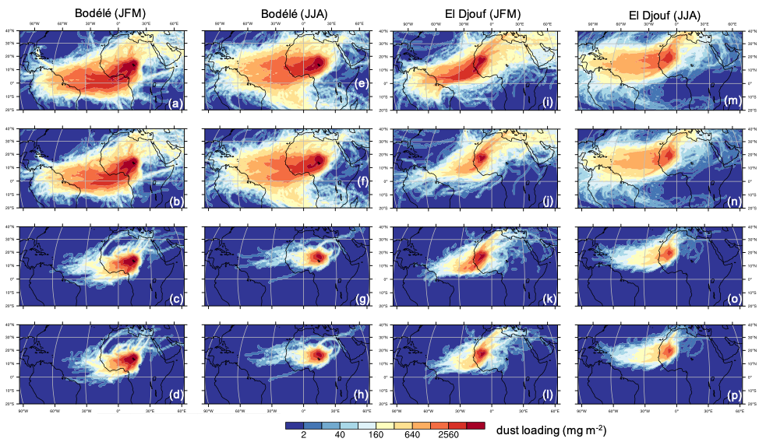
Disproving the Bodélé depression as the primary source of dust fertilizing the Amazon Rainforest
Objective | North African deserts have been reported to export ~200 million tons of dust per year to the tropical Atlantic Ocean, degrading air quality over the Caribbean Islands in boreal summer and supplying nutrients to fertilize the Amazon Rainforest in boreal winter and spring through trans-Atlantic dust transport. It has been assumed that the Bodélé depression is the main contributor to this trans-Atlantic dust transport and Amazonian dust fertilization in boreal winter. However, these claims have not been supported by geochemical analysis. This ongoing debate motivates the current investigation of the relative contribution of specific North African dust sources to the trans-Atlantic dust transport to the Amazon Basin.
New Science | We integrate a suite of satellite observations into a novel trajectory analysis framework to investigate dust transport from the leading two North African dust sources, namely the Bodélé depression and El Djouf, and provide the first ever observation-constrained quantification of the dust’s dry and wet deposition along its transport pathways. The approach yields the novel observational finding that the El Djouf in Mauritania and Mali is the preferred source of inter-continental transport across the Atlantic Ocean rather than the Bodélé depression in Chad, bridging the geochemical impact of North African minerals on the Amazon Basin to the specific dust origin.
Significance | The inclusion of dry and wet deposition processes in the current trajectory modeling enables a realistic simulation of the three-dimensional atmospheric distribution of transported dust and provides an observation-constrained benchmark for testing the assumptions made by previous satellite-based investigations of trans-Atlantic dust transport and for constraining chemistry transport models.
Focus of the current paper
Figure Caption: Spatial distribution of dust loading (mg m⁻²) contributed by dust emission from the (a-h) Bodélé depression and (i-p) El Djouf during (a-d, i-l) January-March (JFM) and (e-h, m-p) June-August (JJA) in 2005-2017. In (a, e, i, m), neither wet or dry deposition is considered, in (b, f, j, n), only dry deposition is considered, in (c, g, k, o), only wet deposition is considered, and in (d, h, I, p), both dry and wet deposition are considered.
Yu, Y., O.V. Kalashnikova, M.J. Garay, H. Lee, M. Notaro, J.R. Campbell, J. Marquis, P. Ginoux, and G.S. Okin, 2020: Disproving the Bodélé depression as the primary source of dust fertilizing the Amazon Rainforest. Geophysical Research Letters, in press.
* Supported by a NASA contract and by the DOE Biological and Environmental Research RGCM Program.

