Slide 1
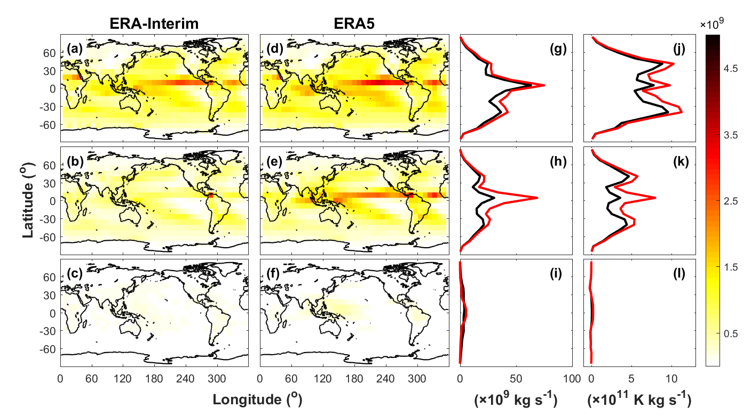
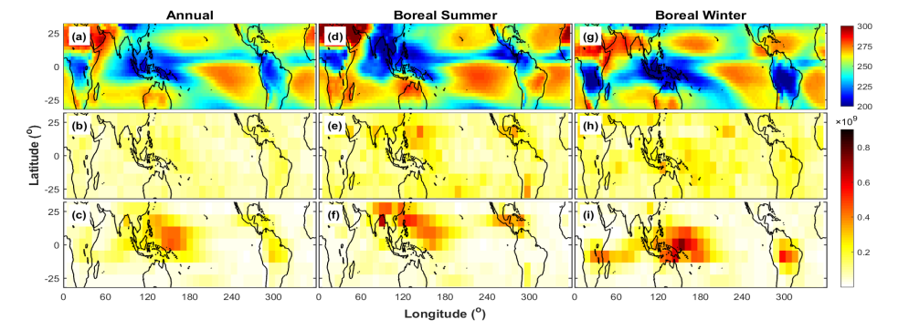
Organized Thunderstorms Significantly Contribute to the Earth’s Energy Cycle
Objectives
The energy received from the sun is redistributed around the globe by atmospheric overturning circulations. This study estimates the mass and energy transports associated with the atmospheric overturning across different spatial scales.
Approach
The atmospheric overturning in the newest-generation (ERA5) and the previous-generation (ERA-Interim) reanalyses from the European Centre for Medium-Range Weather Forecasts are compared based on isentropic averaging that identifies the contribution of different scales
Impacts
This study identified the key roles of mesoscale overturning associated with organized thunderstorms in redistributing energy across the tropics.
The first estimates of multiscale overturning provided by this study are important benchmarks for modeling of tropical circulation and precipitation.
This study motivates a new research priority to understand and model the role of mesoscale convective processes in global energy and water cycles.
850 hPa
500 hPa
175 hPa
Upward mass transport associated with the mesoscale overturning at different vertical levels, showing large differences between ERA-Interim (left) and ERA5 (right) at upper levels (500 hPa and175 hPa)
Outgoing longwave radiation from satellites (top) and mesoscale upward mass transport from ERA-Interim (middle) and ERA5 (bottom). Areas of strong upward mass transport in ERA5 correspond to areas of deep convection (low OLR values).
Chen, X., Pauluis, O. M., Leung, L. R., & Zhang, F. (2020). Significant contribution of mesoscale overturning to tropical mass and energy transport revealed by the ERA5 reanalysis. Geophysical Research Letters, 47, e2019GL085333. https://doi.org/10.1029/2019GL085333

