Slide 1
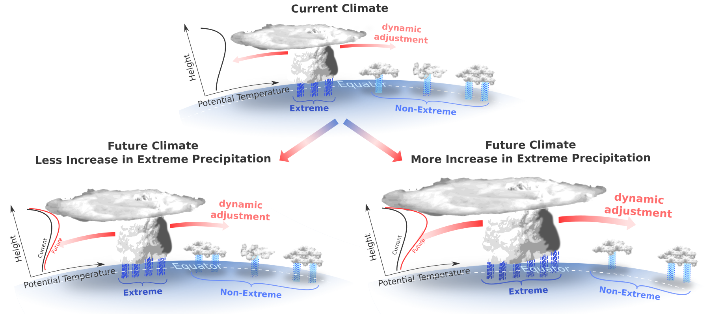
Can we Constrain Uncertainty in Hydrologic Cycle Projections?
Prein, A. F., and A. G. Pendergrass (2019), Can we Constrain Uncertainty in Hydrologic Cycle Projections?, Geophys. Res. Lett., 2018GL081529, doi:10.1029/2018GL081529.
OBJECTIVE
Highlight the role of energetic constraints going beyond global mean precipitation - for extreme and non-extreme events.
APPROACH
Offer an interpretation of the changes in tropical precipitation in response to warming from a recent study (Thackeray et al., 2018).
IMPACT
We illustrate a mechanism that plays a role in the spread of extreme and non-extreme precipitation events across climate models, and highlight future paths toward narrowing the uncertainty in hydrologic cycle change.
Figure: Potential tropical precipitation responses to climate change. The top panel shows non-extreme (light blue rain shafts) and extreme (dark blue rain shafts) tropical precipitation under current conditions. The bottom panels show two possible outcomes of future climate change. In one, where tropical extreme precipitation increases modestly and non-extreme precipitation increase more (lower left); in the other, extreme precipitation rapidly increases at the cost of non-extreme events, which slightly decrease (lower right). A potential mechanism is that when extreme storms increase faster they release more latent heat, which increases stability across the tropical mid- to upper-troposphere by dynamical adjustment, reducing the probability and/or intensity of non-extreme precipitation storm development

