Slide 1
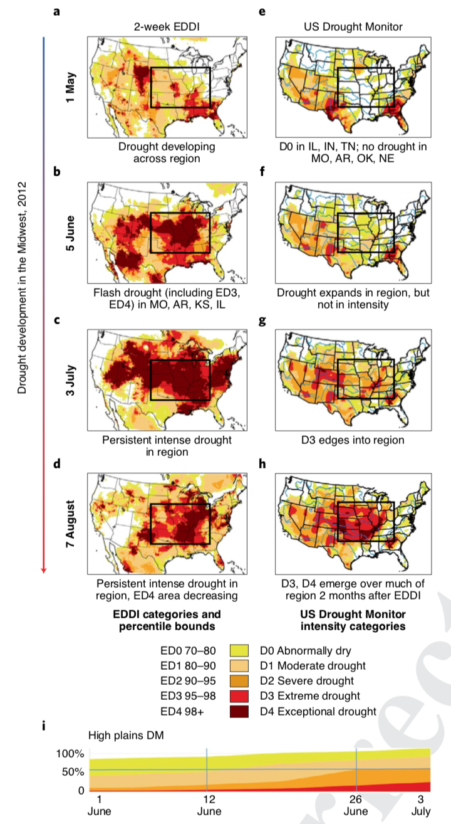
Flash droughts present a new challenge for subseasonal-to-seasonal prediction
Pendergrass, A.G., Meehl, G.A., Pulwarty, R., Hobbins, M., Hoell, A., AghaKouchak, A., Bonfils, C.J.W., Gallant, A.J.E., Hoerling, M., Hoffmann, D., Kaatz, L., Lehner, F., Llewellyn, D., Mote, P., Neale, R., Overpeck, J.T., Sheffield, A., Stahl, K., Svoboda, M., Wheeler, M.C., Wood, A.W., Woodhouse, C.A., 2020. Nature Climate Change. doi: 10.1038/s41558-020-0709-0.
OBJECTIVE
Flash droughts are a recently recognized type of extreme event distinguished by sudden onset and rapid intensification of drought conditions with severe impacts. They unfold on subseasonal to seasonal (S2S) timescales (weeks to months), presenting a new challenge for the surge of interest in improving S2S prediction. We address what is needed to make progress on understanding, predicting, and preparing for them?
APPROACH
In this perspective, we discuss existing prediction capability for flash droughts and what is needed to establish their predictability. We place them in the context of synoptic to centennial phenomena, consider how they could be incorporated into early warning systems and risk management, and propose two definitions.
Figure. Evolution of a flash drought across the US Midwest in 2012. (a-d) Evaporative Drought (ED) categories based on two-week Evaporative Demand Drought Index (EDDI) at five-week intervals during the drought onset. (e-h) US Drought Monitor (USDM). (i) Percent of High Plains region in USDM categories from 1 June- 3 July 2012. Adapted with permission.
IMPACT
The growing awareness that flash droughts involve particular processes and severe impacts, and likely a climate change dimension, make them a compelling frontier for research, monitoring, and prediction.

