Slide 1
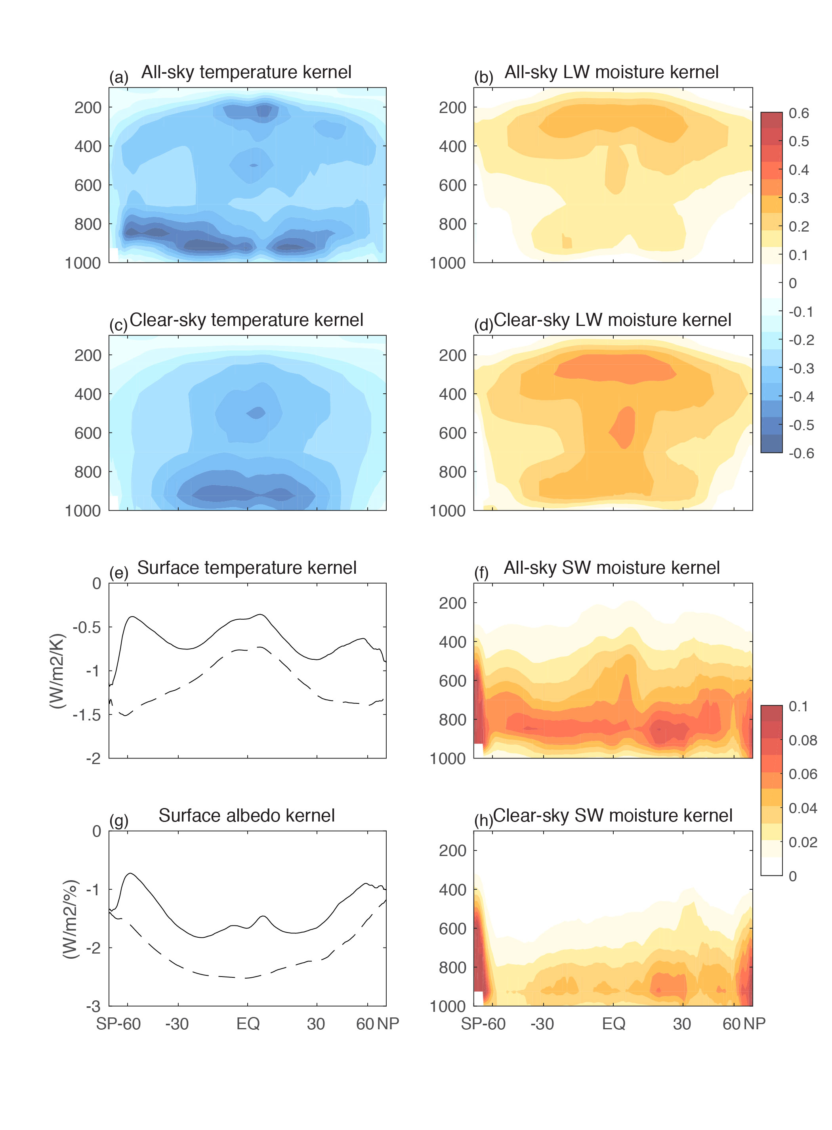
CAM5 Top-of-Atmosphere and Surface Radiative Kernels
Pendergrass, A. G., Conley, A., and Vitt, F. M.: Surface and top-of-atmosphere radiative feedback kernels for CESM-CAM5, Earth Syst. Sci. Data, 10, 317-324, https://doi.org/10.5194/essd-10-317-2018, 2018.
OBJECTIVE
Radiative kernels are a tool used to decompose changes in radiative fluxes into components associated with temperature, water vapor, and surface albedo. They can also be used indirectly to diagnose the contribution of changes in clouds to radiative fluxes. Previous sets of kernels for the TOA exist, but few surface kernel datasets do, and no model-based kernels had been validated prior to this study. Furthermore, a complete technical description of how to generate and use kernels had never before been published.
TOA radiative kernels
APPROACH
The kernels were generated using offline radiative transfer calculations with CAM5-PORT. The kernels, radiative forcing, and demo data were released on NCAR’s ESG, and software to implement the kernels are provided on Github. The data and also software to implement them are available for the community.
IMPACT
The radiative kernels are already being used by the community, with the first publications citing the dataset coming out alongside its documentation.
Top-of-atmosphere kernels from CESM1(CAM5). Zonal, annual-mean temperature, longwave moisture, and shortwave moisture kernels for all-sky and clear-sky. In panels (e) and (g) all-sky kernels are shown in solid lines and clear-sky kernels in dashed lines. The sign convention is positive downward

