Slide 1
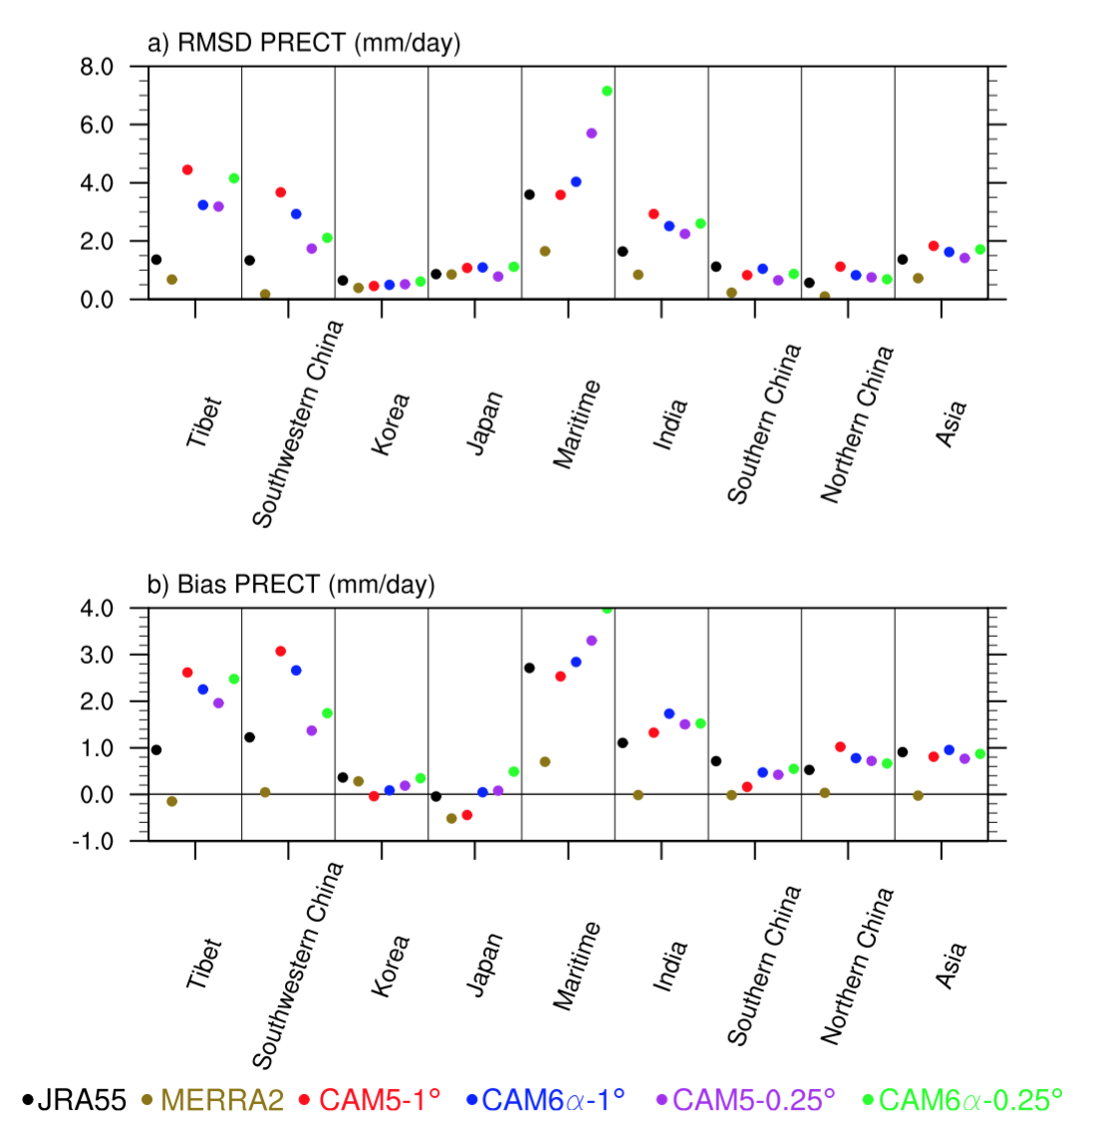
CAM6 simulation of mean and extreme precipitation over Asia Parameterizations and Resolution Sensitivity
Lin, L., Gettelman, A., Xu, Y., Wu, C., Wang, Z., Dong, W., Bates, S. C., and N. A. Rosenbloom, 2019: CAM6 simulation of mean and extreme precipitation over Asia: Sensitivity to upgraded physical parameterizations and higher horizontal resolution, Geosci. Model Dev. Discuss., https://doi.org/10.5194/gmd-2019-1.
OBJECTIVE
Because CESM2/CAM6 is participating in the CMIP6 and is likely to be adopted in many future studies, its simulation fidelity needed to be thoroughly examined. This study evaluates the performance of CAM6 in both low (1°) and high (0.25°) resolution configurations compared to various observational and reanalysis datasets of precipitation over Asia.
APPROACH
Compare precipitation measures from CAM6 (CMIOP6) to CAM5 (CMIP5) and observations.
IMPACT
1) Prognostic treatment of precipitation processes and the new microphysics module lead to a better representation of climatological mean and extreme precipitation over Asia, heaviest precipitation events, diurnal cycle of precipitation rates over most of Asia, and probability density distributions of daily precipitation over Tibet, Korea, Japan and Northern China. 2) Higher horizontal resolution leads to better representation of mean and extreme precipitation over Northern China.
The root mean squared difference (RMSD, top) and bias (bottom) of annual mean precipitation (mm/day) relative to APHRODITE for JRA55, MERRA2, CAM5-1º, CAM6-1º and CAM6-0.25º over 9 regions.

