Slide 1
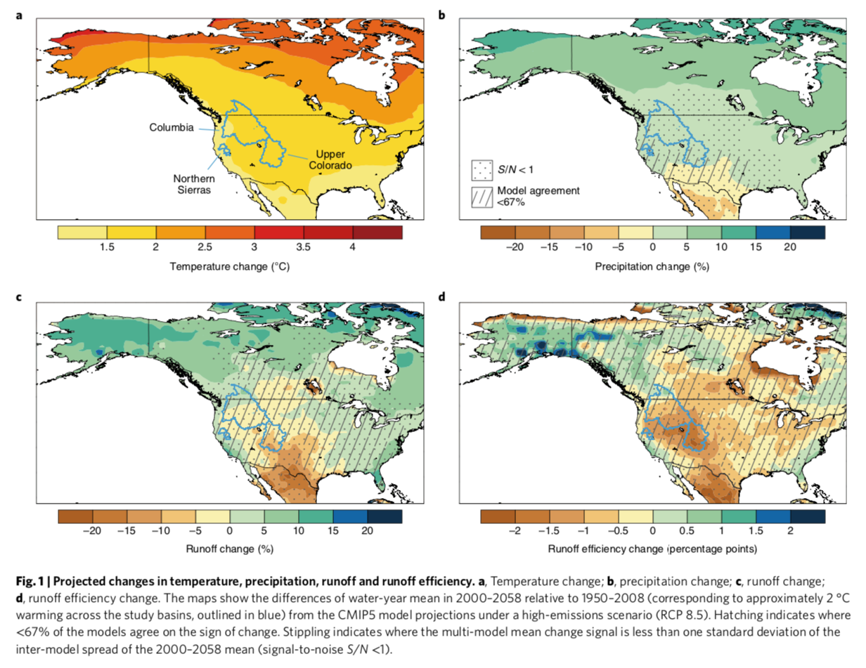
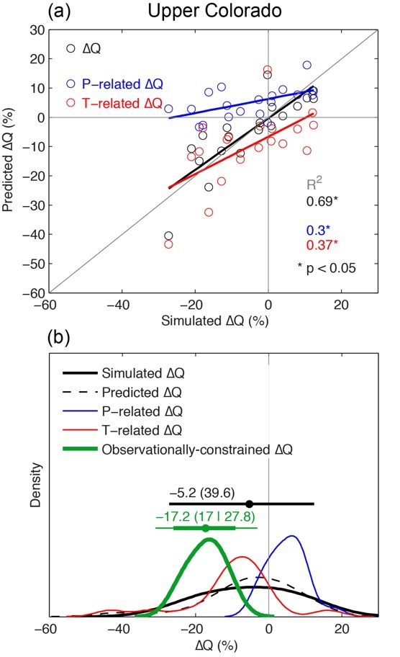
The potential to reduce uncertainty in regional runoff projections from climate models
Flavio Lehner, Andrew W. Wood, Julie A. Vano, David M. Lawrence, Martyn P. Clark, Justin S. Mankin:
Nature Climate Change, 9, 926–933 (2019) doi:10.1038/s41558-019-0639-x
OBJECTIVE
How will runoff change with climate change? Even if we knew how precipitation would change, we would still face uncertainty on how precipitation change translates into runoff changes (“runoff sensitivity”). Here we try to understand where the knowledge gap is and how it can be closed.
APPROACH
We benchmark climate models with observational estimates of runoff sensitivity and derive an observational constraint on future runoff projections.
IMPACT
The observational constraint has the potential to greatly reduce uncertainty in future runoff projections, which will guide both model development as well as climate change adaptation in water-scarce regions.

