Slide 1

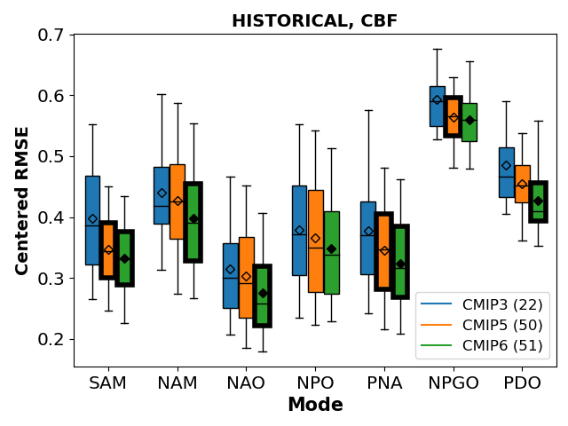
Benchmarking performance changes in the simulation of extratropical modes of variability across CMIP generations
Objective:
Evaluate extratropical modes of variability in the ~800 simulations from three most recent phases of the Coupled Model Intercomparison Project (CMIP3, 5, and 6) to gauge improvement of climate models over time.
Results:
Simulated spatial patterns of modes have been significantly improved in CMIP6, while little improvement and systematic overestimation in the mode amplitude found in the newer models, indicating bias in amplitude is still a challenge.
Some potential contributions to the pattern improvement of certain modes were identified (e.g., mean field, high-top); however, the performance changes are likely attributed to gradual improvement of the base climate and multiple relevant processes.
The amplitude skill relationship identified between Historical and AMIP simulations suggests that successfully rectifying the systematic overestimation of amplitude in AMIP may also lead to improvement in the more computationally and labor-intensive Historical simulations.
Overall improvement is significant in many cases.
Impact:
We have demonstrated that many modes of variability can be diagnosed in atmospheric-only mode, making future improvement of models more trackable.
Lee, J, K. Sperber, P. Gleckler, K. Taylor, C. Bonfils, 2021: Are newer climate models better in simulating extratropical modes of variability than older ones?: A comparison between CMIP3, 5, and 6 models. J. Climate (in publication), https://doi.org/10.1175/JCLI-D-20-0832.1
Notes:
Figure captions:
[top]
Portrait Plots of normalized centered RMSE summarizing model skill in simulating mode patterns in Historical simulations of CMIP3, 5, and 6, using the CBF method. In the Portrait Plots, for each row the centered RMSE is normalized by the median centered RMSE. Thus, a value of -0.5 indicates that the error is 50% smaller than the median or typical model error, and a value of 0.5 indicates that the error is 50% larger than the median error. From left to right are the skill scores for CMIP3, CMIP5, and CMIP6 with the grey horizontal bar separating each CMIP generation. For sea-level pressure based modes (SAM, NAM, NAO, NPO, and PNA) in the upper-left hand triangle the model results are shown relative to 20CR whereas in the lower-right triangle the model results are shown relative to the ERA-20C. For SST based modes (NPGO and PDO), results are shown relative to HadISSTv1.1 (upper-left triangle) and HadISSTv2.1 (lower-right triangle). Numbers in parentheses following model names indicate the number of ensemble members for the model. Metrics for individual ensemble members were averaged for each model.
[low]
Centered RMSE from CMIP models calculated against the 20CR/HadISSTv1.1 reference dataset, displayed as box plots and obtained from Historical for all seasons (units: hPa for SAM, NAM, NAO, NPO, and PNA; and ºC for NPGO and PDO) using the CBF method. Note: top and bottom of each box are for 25th and 75th percentiles; top and bottom whiskers indicate 5th and 95th percentiles; and horizontal bar and marker indicate median and mean, respectively. When the box has a thicker edge line, it indicates the difference to its immediate earlier MIP (i.e., CMIP5 vs 3 or CMIP6 vs 5) is significant. When the mean marker is filled for CMIP6, it indicates the difference to CMIP3 is significant. The significance is determined by t-test when p-value < 0.05.

