Slide 1

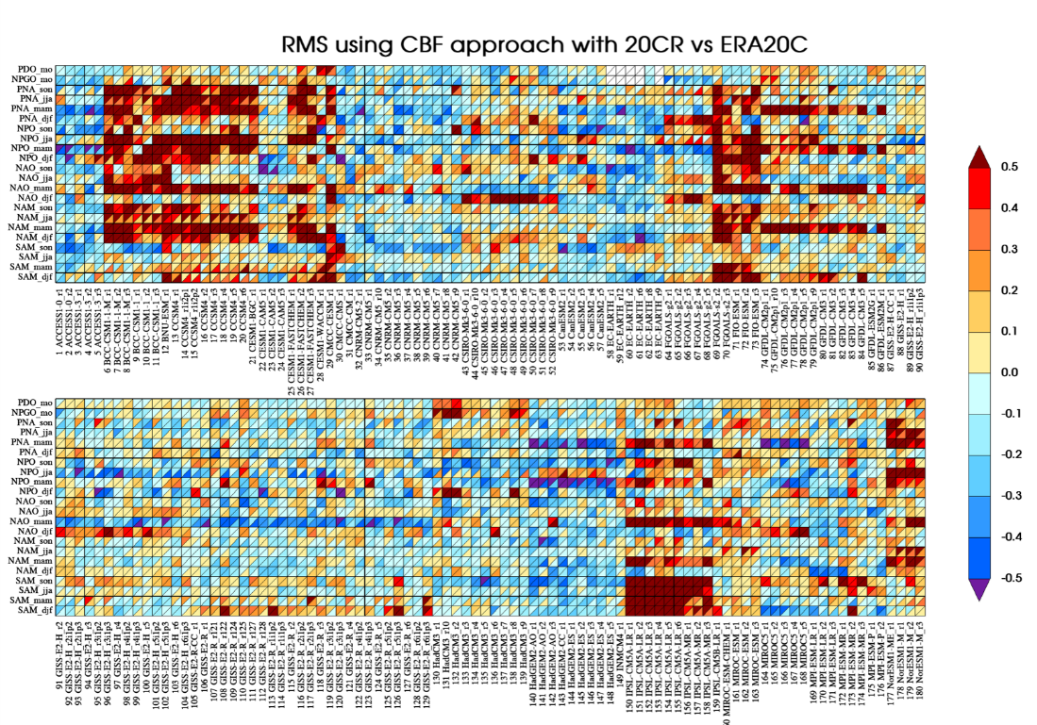
Earth system model variability metrics
Objective: Develop an innovative set of objective tests and metrics to gauge how well Earth system models (ESMs) simulate observed modes of extratropical variability.
Research: Exploring several viable approaches, a new analysis method, the “Common Basis Function” approach, has been implemented. Our approach indicates that modern ESMs (CMIP5) are performing better than hitherto suggested, with in many cases the dominant bias being an overestimation of variability.
Impact: This study provides robust metrics to compare simulated interannual to interdecadal variability with observations that was previously lacking. This will enable a more rigorous examination of simulated variability and help improve our understanding of ESM behavior.
Extratropical modes of variability
Metrics summary: Root-mean-square error
Lee, J., K. Sperber, P. Gleckler, C. Bonfils, K. Taylor, 2018:
Quantifying the agreement between observed and simulated extratropical modes of interannual variability, Clim Dyn, (doi: https://doi.org/10.1007/s00382-018-4355-4)

