Slide 1
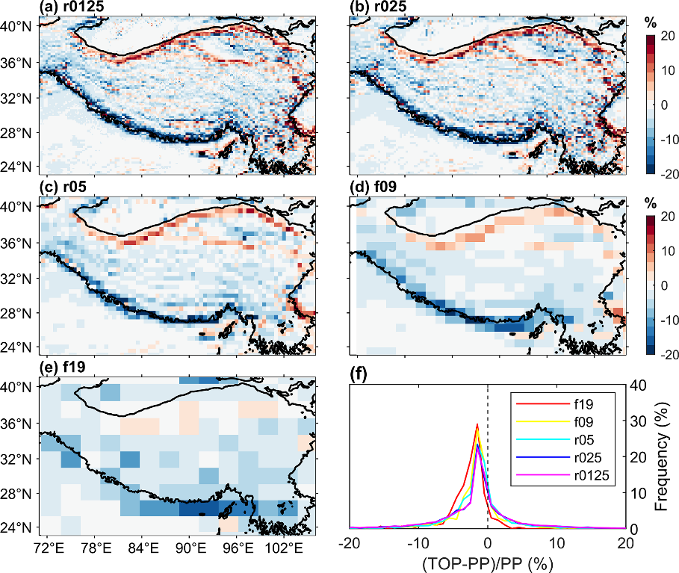
More Accurately Representing Topography Impacts in Modeled Land Surface Processes
Objective
Implement and evaluate a solar radiation parameterization that accounts for sub-grid topographic effects in the Energy Exascale Earth System Model Land Model (ELM).
Approach
Incorporate a well-validated sub-grid topographic (TOP) parameterization in ELM.
Perform ELM simulations with the original plane-parallel (PP) and improved TOP schemes over the Tibetan Plateau across spatiotemporal scales.
Compare the sets of ELM simulations with remote sensing data.
Impact
Topography has non-negligible effects on the modeled surface energy budget and snow processes over the Tibetan Plateau.
The magnitude of the sub-grid topographic effects depends on the season, elevations, and spatial scale studied.
The new TOP scheme reduces the biases of ELM for simulating surface energy balance and snow hydrology, especially in high-elevation and snow-covered regions.
The relative differences of land surface albedo between
TOP and PP schemes in winter at different spatial scales (a–e, ranging from 0.125—2 degrees) and the statistical histogram of their frequency distributions (f). The sub-grid topographic effects are stronger at higher spatial resolutions.
Hao, D., Bisht, G., Gu, Y., Lee, W., Liou, K.-N., and Leung, L. R. “A Parameterization of Sub-grid Topographical Effects on Solar Radiation in the E3SM Land Model (Version 1.0): Implementation and Evaluation Over the Tibetan Plateau,” Geosci. Model Dev., 14, 6273–6289, (2021). [DOI: 10.5194/gmd-14-6273-2021]
Notes:
http://www.pnnl.gov/science/highlights/highlights.asp?division=749

