Slide 1
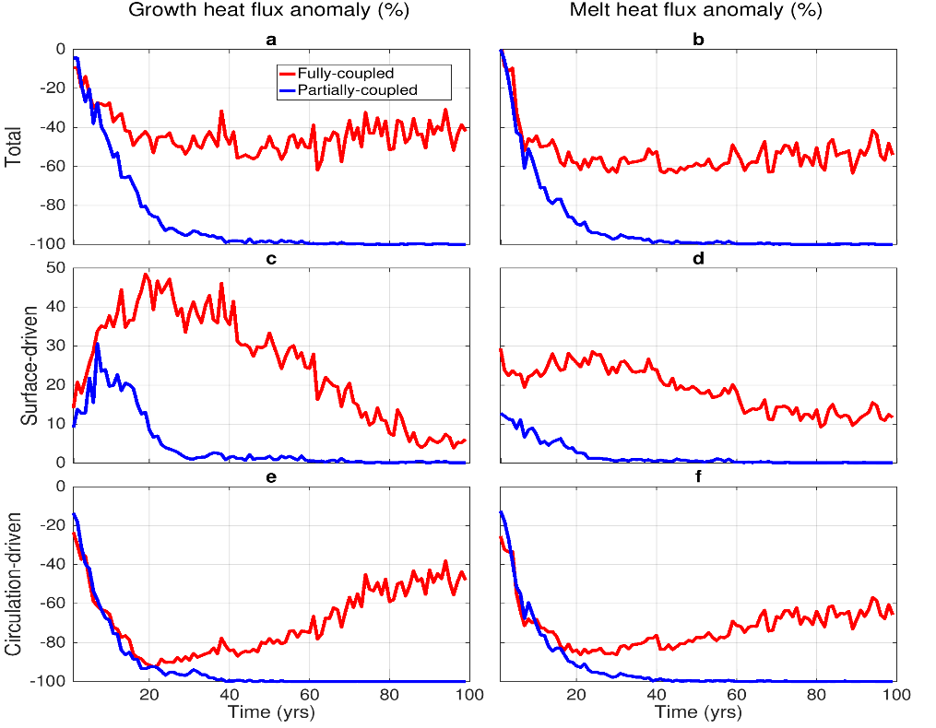
Disentangling the Complex Interactions Driving CO₂-Related Arctic Sea Ice Loss
Objective
Develop a new method for isolating the individual roles of the atmosphere and ocean in Arctic sea ice loss.
Approach
Use special tracers that track the sources of ocean heat storage changes to decompose ocean-induced sea ice growth and melt changes into components produced by the ocean’s surface heat input or circulation changes.
Employ a sea ice volume budget analysis to identify the contribution of ocean-induced sea ice growth and melt to the overall Arctic sea ice volume change.
Isolate the impact of atmosphere-ocean interaction on the process in a partially coupled experiment that supports a one-way, rather than the traditional two-way atmosphere-ocean interaction.
Impact
Provided clear insight into the impact of the ocean heat storage components on sea ice growth and melt.
Improved scientific understanding of the mechanisms by which coupled climate interactions cause Arctic sea ice loss.
Graphs of CO₂ induced changes in ocean heat, which causes sea ice growth and melt. Reds show percentage change in the fully coupled experiment while blues indicate changes in the partially coupled experiment. Panels a and b show totals from the fully and partially coupled experiments; c and d shows percentage changes caused by changes in the ocean’s surface heat input; while e and f show changes caused by ocean circulation changes. The plot shows ocean circulation changes, rather than surface heat input, cause declines in ocean-induced ice growth and melt. In the absence of the two-way air-sea interaction of the fully coupled experiment, ocean-induced ice melt and growth completely decline.
O.A. Garuba, H. A. Singh, E. Hunke, & P. J. Rasch. “Disentangling the coupled atmosphere‐ocean‐ice interactions driving Arctic sea ice response to CO₂ increases.” Journal of Advances in Modeling Earth Systems, 12, e2019MS001902, (2020). http://doi.org/10.1029/2019ms001902

