Slide 1
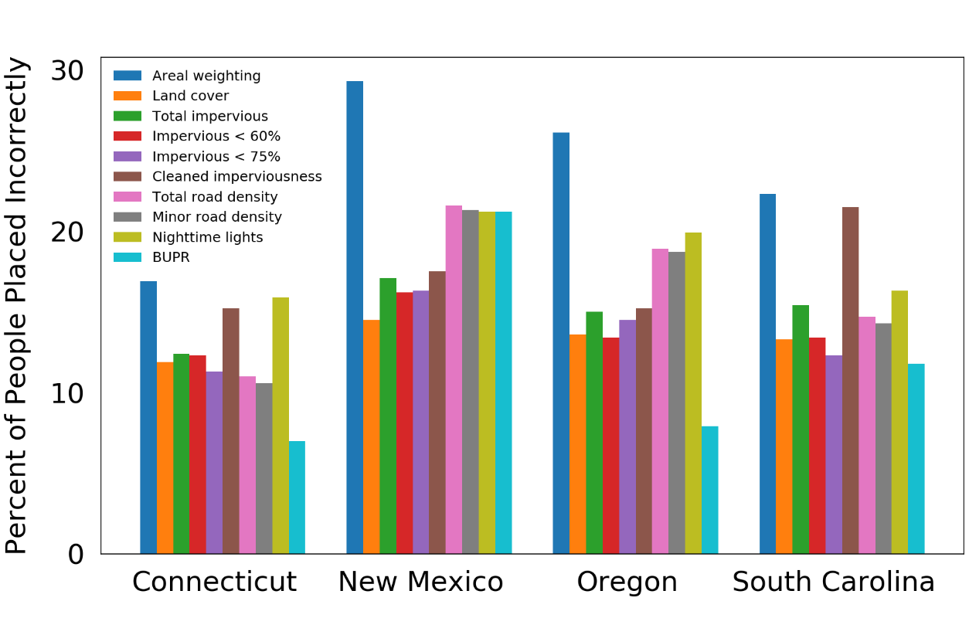
A New Population Downscaling Method Based on U.S. Property Data
Objective
Downscale population from the census tract level to the block group level based on a novel settlement-related dataset.
Approach
Aggregate Built-Up Property Records (BUPR) from the Historical Settlement Data Compilation for the United States for each block group and use those values as population redistribution weights to redistribute population from census tracts to its corresponding block groups.
Calculate population downscaling accuracy for comparison with other traditionally-used methods.
Impact
The BUPR-based population downscaling outperforms other traditionally-used methods and can be applied to most of the U.S. as long as census data is available.
The newly developed BUPR-based method outperforms the other traditional methods in studied states that have a wide range of population densities.
Wan H, J Yoon, V Srikrishnan, B Daniel, and D Judi. In Press. “Population Downscaling Using High-Resolution, Temporally-Rich U.S. Property Data.” Cartography and Geographic Information Science, 49(1), 18-31, (2022). [DOI: 10.1080/15230406.2021.1991479].

