Slide 1
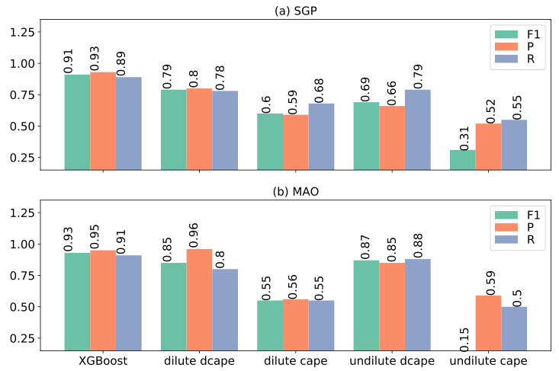
Improving convection trigger functions in deep convective parameterization schemes using machine learning
Objective
Build deep convection trigger functions using the XGBoost method, trained by ARM continuous forcing and evaluation data at SGP and MAO sites.
Finds
The ML convective trigger function greatly outperforms four convective available potential energy (CAPE) based triggers at the two sites.
A series of augmented rules are derived from the ML trigger. That could be used to improve existing traditional CAPE-based triggers.
Impact
The improved ML convection trigger functions and insights derived from the ML trigger could reduce uncertainties in deep convective parameterization schemes.
The performance of convection trigger functions at (a) SGP and (b) MAO. F1, Precision (P) and Recall (R) are the three performance criteria that are calculated based on the contingency table.
Zhang, T., Lin, W., Vogelmann, A. M., Zhang, M., Xie, S., Qin, Y., & Golaz, J.-C. 2021. "Improving convection trigger functions in deep convective parameterization schemes using machine learning." Journal of Advances in Modeling Earth Systems, 13, e2020MS002365. https://doi.org/10.1029/2020MS002365

