Slide 1

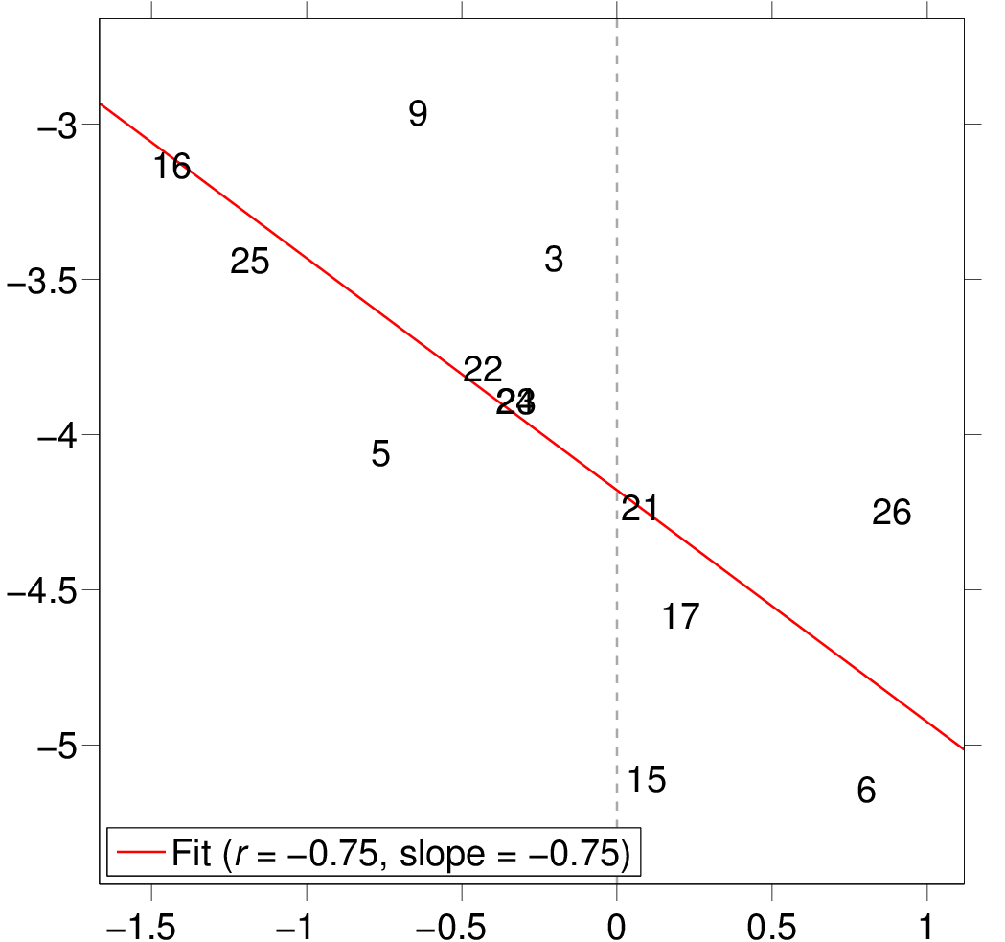
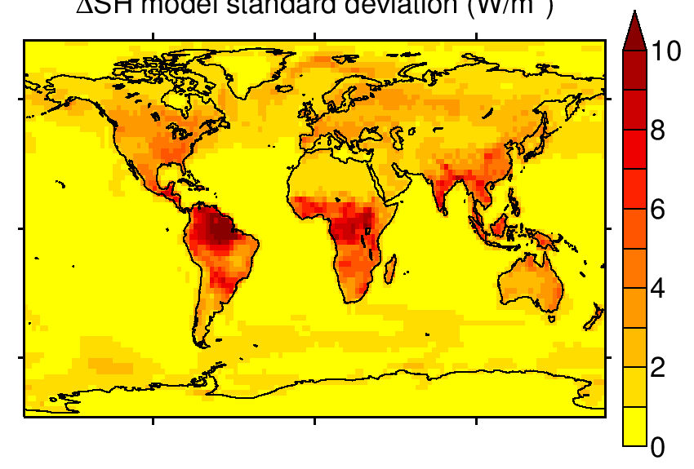
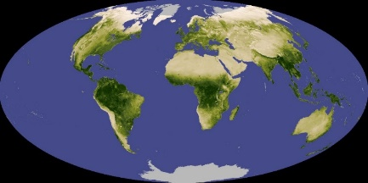
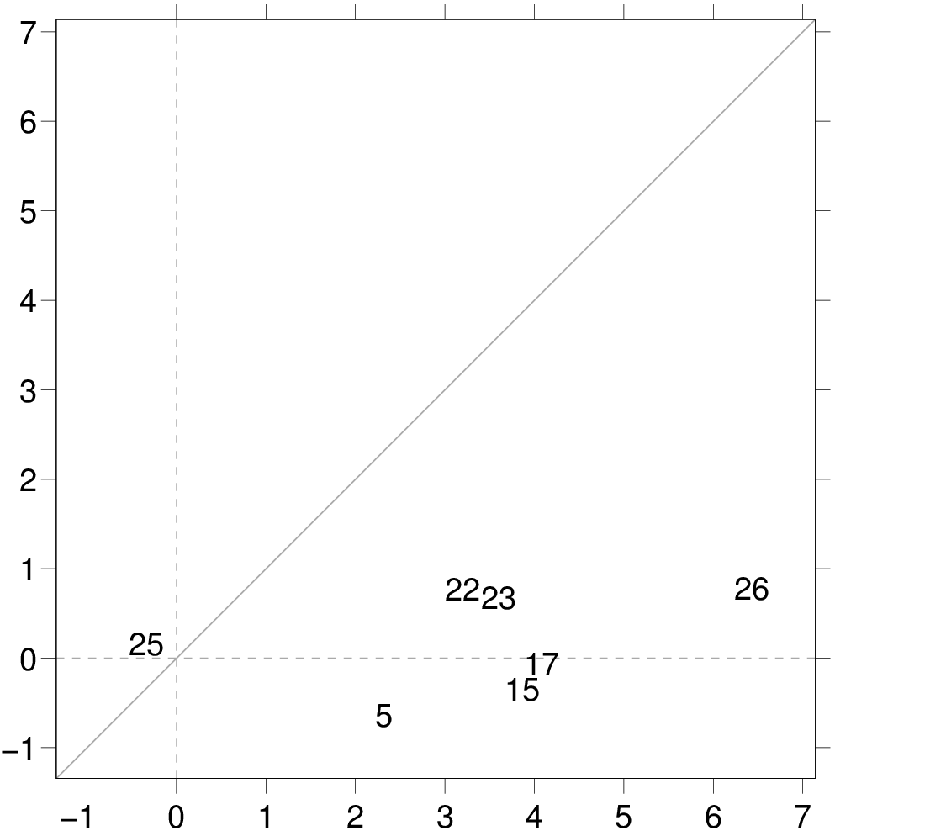
Model spread in the fast response of global precipitation to CO₂ forcing
Anthony M. DeAngelis, Xin Qu, and Alex Hall
Spread in sensible heat response
Scientific Question:
What causes climate model differences in the rapid decrease of global precipitation in response to abruptly increased CO₂?
Global precipitation response
Approach:
different models
Analyze fast responses in 26 CMIP5 models using a variety of experiments. Focus on spatial patterns and physical processes/mechanisms.
Global sensible heat response (W/m²)
Vegetation
Key Findings:
Land-mean sensible heat response
Model differences in the rapid change of land surface sensible and latent heat flux are a main source of difference in the global precipitation response.
Differences in the land heat flux response can be traced to the vegetation physiological response to increased CO₂, particularly stomatal closure.
An evaluation of the modeled vegetation response, including the parameterization of stomatal conductance, may help constrain the spread.
Vegetation does not respond to CO₂
(amip4xCO2)
Publication:
Vegetation responds to CO₂ (sstClim4xCO2)
DeAngelis, A. M., Qu, X., & Hall, A. Importance of vegetation processes for model spread in the fast precipitation response to CO₂ forcing. Geophys. Res. Lett., 43, 12550-12559, doi: 10.1002/2016GL071392 (2016).
Notes:
Background: On annual and longer time scales, the global-mean atmospheric energy budget is in balance. Net cooling from longwave radiation is balanced by heating from shortwave absorption, sensible heat flux from the surface to atmosphere, and latent heat release from precipitation. Following an increase in greenhouse gases, the land and atmosphere adjust on a timescale much shorter than that of the ocean, causing a decrease in global precipitation prior to a subsequent increase that is driven primarily by slow oceanic warming. Specifically, when CO₂ increases, atmospheric longwave cooling becomes suppressed and there is a net downward radiative perturbation over land. This causes rapid atmospheric and land warming, both of which act to increase atmospheric stability over important oceanic convective regions, decreasing precipitation there (and also globally averaged). While a decrease in global precipitation is robust among models, its magnitude varies by a factor of 2. Variability in this fast response of precipitation contributes to model differences in the projected end-of-21st-century total increase in global precipitation under a realistic forcing scenario. It is thus important to understand what is causing the spread in the fast precipitation decrease.
Figure descriptions:
(top) The fast response of global-mean precipitation is compared with that of global-mean surface sensible heat flux for each model (each number is a different model). Fast responses are computed as the difference in 30-year climatology between a fixed-SST simulation with atmospheric CO₂ at its preindustrial level and one with atmospheric CO₂ quadrupled from that level (i.e., sstClim4xCO2-sstClim). Simulated climatological SSTs based on the pre-industrial run are imposed in these experiments. The top right shows the intermodel standard deviation of the fast sensible heat flux response as a function of location, computed in the same fashion as the scatterplot to the left. Below that figure is a map of global vegetation coverage (darker green is denser vegetation) from NASA. A comparison of the two maps clearly shows that the model spread in the land surface sensible heat flux response is largest over vegetated areas. Not shown in these figures is the important finding that the land sensible and latent heat flux fast responses are anti-correlated across models. Thus, model differences in the partitioning of surface sensible and latent heat flux response are important for spread in the global-mean fast precipitation response. This occurs because there is a teleconnection between the land heat flux response and tropical oceanic convective precipitation, which operates via tropical dynamics and thermodynamics. More details about this teleconnection are provided in the paper.
(bottom) The land-mean sensible heat flux fast response (between 60S and 80N) is computed as sstClim4xCO2-sstClim (abscissa, as in the top panels) and amip4xCO2-amip (ordinate) for a subset of models. The amip simulations are distinct from the sstClim simulations in two ways: 1) SSTs in the amip simulations are prescribed based on observations and are time-varying over 1979-2008 (this has little effect on the results, not shown), 2) the terrestrial carbon cycle was inactivated (or at a minimum, vegetation did not see the increase in CO₂) in the amip4xCO2 simulations. The comparison allows one to see the influence of the vegetation response to CO₂ (a large part of which is stomatal closure) on the model spread in land surface heat flux response. Clearly, the spread is larger when vegetation sees in the increase in CO₂ (similar results are obtained if latent heat flux is shown instead). The larger spread is because of several reasons: 1) in some models (here, #25), leaf stomatal conductance is not a function of atmospheric CO₂ concentration, so stomata do not close when CO₂ increases, 2) vegetation parameterizations (of stomata closure and otherwise) differ among models, and 3) other processes such as boundary layer physics and fast cloud responses may differ even with the same vegetation response.
The model relationship between the fast response of global precipitation and sensible heat flux is also found with an approach based on regression (not shown on the slide). In this approach, annual anomalies in the atmospheric energy budget components are regressed against those in surface air temperature in a simulation in which atmospheric carbon dioxide is abruptly quadrupled. The y-intercept of the best-fit regression line represents the fast response. We focus on the fixed-SST approach in our analysis because those simulations allow for a more reliable estimate of spatial patterns of the fast response.

