Slide 1
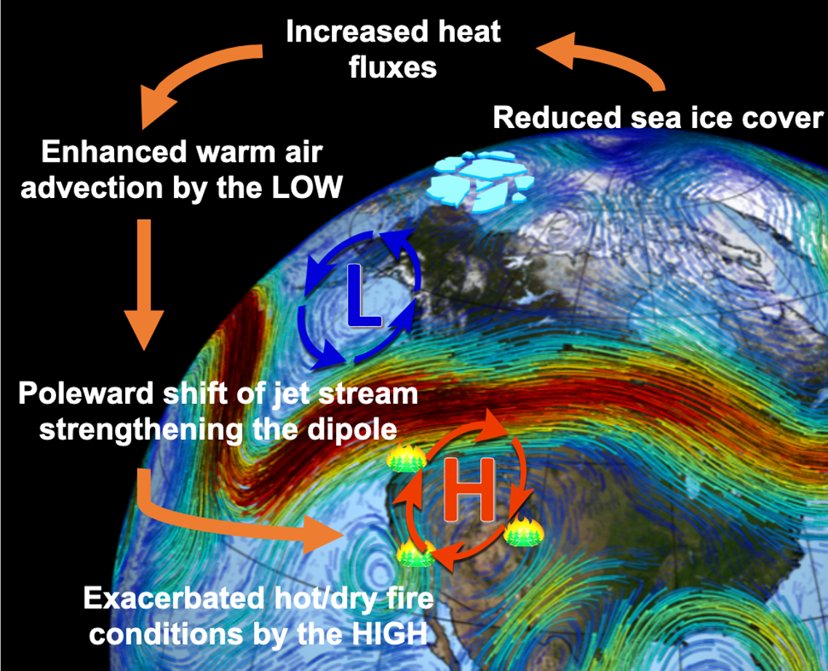
Declining Arctic Sea Ice May Increase Wildfires in the Western United States
Objective
Quantify the relationship between changes in summer Arctic sea ice concentration and autumn wildfires over the western United States.
Describe the teleconnection mechanisms that explain the linkage between Arctic sea ice and U.S. wildfires.
Approach
Analyze observationally-based reanalysis data (1980−2019) to identify the teleconnection linking regional fire weather and burning activity with Arctic sea ice changes.
Conduct model experiments using a state-of-the-art, fire-enabled climate model to tease out the physical mechanisms.
Impact
A shift to more fire-favorable weather is associated with declines in Arctic sea ice during summer worsens autumn wildfires over the western United States through regional circulation changes with poleward-shifted polar jet stream.
Fire weather changes driven by declining Arctic sea ice during the past four decades are of similar magnitude to other leading modes of climate variability.
A schematic diagram showing the teleconnection between Arctic sea ice loss and increasing wildfire hazards over the western United States through regional circulation changes.
Zou, Y., Rasch, P.J., Wang, H. et al. Increasing large wildfires over the western United States linked to diminishing sea ice in the Arctic. Nat Commun 12, 6048 (2021). https://doi.org/10.1038/s41467-021-26232-9
Notes:
http://www.pnnl.gov/science/highlights/highlights.asp?division=749

