Slide 1
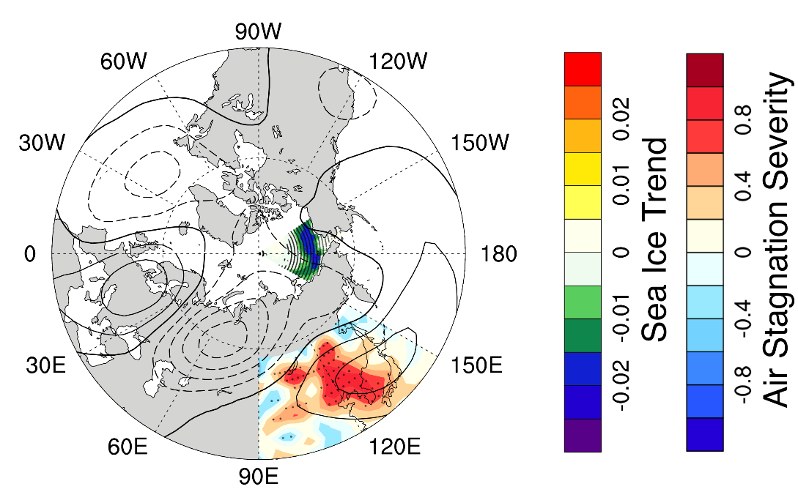
Declines in Sea Ice Connected to Increasing Mid-Latitude Haze Extremes
Objective
Understand the physical mechanism and dynamic pathways linking declining Arctic sea ice and increasing regional air stagnation and haze extremes in winter
Approach
Analyze historical data to reveal the statistical relationship between Arctic changes and meteorological conditions affecting regional pollution
Design and conduct a series of climate sensitivity experiments to evaluate the above relationship and understand the root cause
Confirm the suggested forcing-response relationship with other Earth system models in the CMIP6 project
Impact
A better understanding of sub-polar impacts of Arctic changes could improve the sub-seasonal to seasonal predictability of weather and air quality
An explanation for how Arctic changes can drive meteorological conditions that affect regional air pollution is germane to policy makers concerned with pollution control and mitigation
This Eurasian teleconnection (contours) links regional Arctic sea ice declines (color shading in the Arctic) to increased air stagnation (color shading over East Asia) and pollution extremes over East Asia.
Zou Y, Y Wang, Z Xie, H Wang, and PJ Rasch. 2020. “Atmospheric teleconnection processes linking winter air stagnation and haze extremes in China with regional Arctic sea ice decline,” Atmospheric Chemistry and Physics, 20: 4999–5017.
DOI: 10.5194/acp-20-4999-2020
Notes:
http://www.pnnl.gov/science/highlights/highlights.asp?division=749

