Slide 1
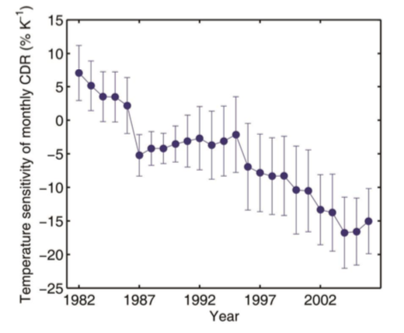
Recent warming has resulted in smaller gains in net carbon uptake in northern high latitudes
Scientific Achievement
We used atmospheric CO2 observations to find that the sensitivity of carbon drawdown to inter-annual temperature changes has trended toward less carbon uptake for a given amount of warming from 1974 to 2014
These results suggest that relatively warm springs now result in less carbon uptake
Similarly relatively warm summers now result in greater carbon release.
Significance and Impact
Our analysis suggests that the weakened spring sensitivity of CDR may be related with the slowdown in seasonal soil thawing rate, while the summer sensitivity change may be caused by the temporally coincident decrease in temperature sensitivity of photosynthesis.
The results suggest that the current NHL carbon sink may become unsustainable as temperatures warm further
Current carbon cycle models do not represent the decrease temperature sensitivity
Figure: The temperature sensitivity of monthly CO2 drawdown rate from 1974 to 2014 over northern high latitudes, derived from atmospheric observations from Barrow, Alaska. The error bars represent standard errors with bootstrap estimates.
Research Details
Carbon balance of terrestrial ecosystems in the northern high latitudes is sensitive to climate change. Here we assess long-term changes in the sensitivity of the carbon balance to environmental changes, and using atmospheric observations show a declining sensitivity over time.
Zhu P, Zhuang Q, Welp L, Ciais P, Heimann M, Peng B, Li W, Bernacchi C, Roedenbeck C, Keenan TF (2019) Recent warming has resulted in smaller gains in net carbon uptake in northern high latitudes. Journal of Climate (in press) DOI: 10.1175/JCLI-D-18-0653.1

