Slide 1
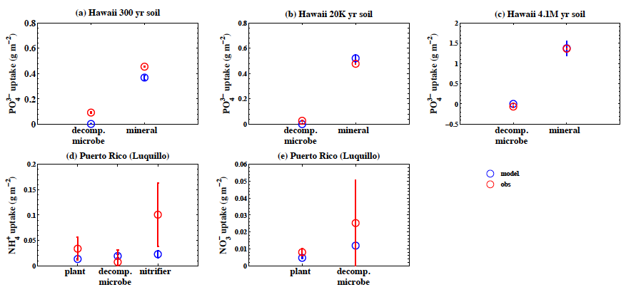
Multiple soil nutrient competition between plants, microbes, and mineral surfaces
Objective:
Develop, calibrate, and test a nutrient competition model that accounts for multiple soil nutrients and abiotic consumers
Calibrate and test model against N and P fertilization experiments
Predict dynamic competitive regimes
Research:
The model includes three primary soil nutrients (NH₄⁺, NO₃⁻, PO_{x}) and five competitors (plant roots, decomposing microbes, nitrifiers, denitrifiers, and mineral surfaces)
Competition modeled with the Equilibrium Chemistry Approximation (ECA)
Calibrated at a tropical forest site (Tapajos)
Tested at two other tropical forest sites (Hawaii and Puerto Rico)
Impact:
The model accurately replicated the experimentally manipulated forest responses that were not used in model calibration
Relative competitiveness of consumers was dynamic. For NH₄, nitrifiers and decomposers were comparably competitive and out-competed roots
These mechanisms are being integrated in ALM and tested against >80 field studies
Reference: Zhu, Q., W. J. Riley, J. Y. Tang, and C. D. Koven (2015), Multiple soil nutrient competition between plants, microbes, and mineral surfaces: Model development, parameterization, and example applications in several tropical forests, Biogeosciences Discussion, 12, doi:10.5194/bgd-12-4057-2015, 4057-4106.
Notes:
Wanda says that this is a general slide with no specific reference

