Slide 1
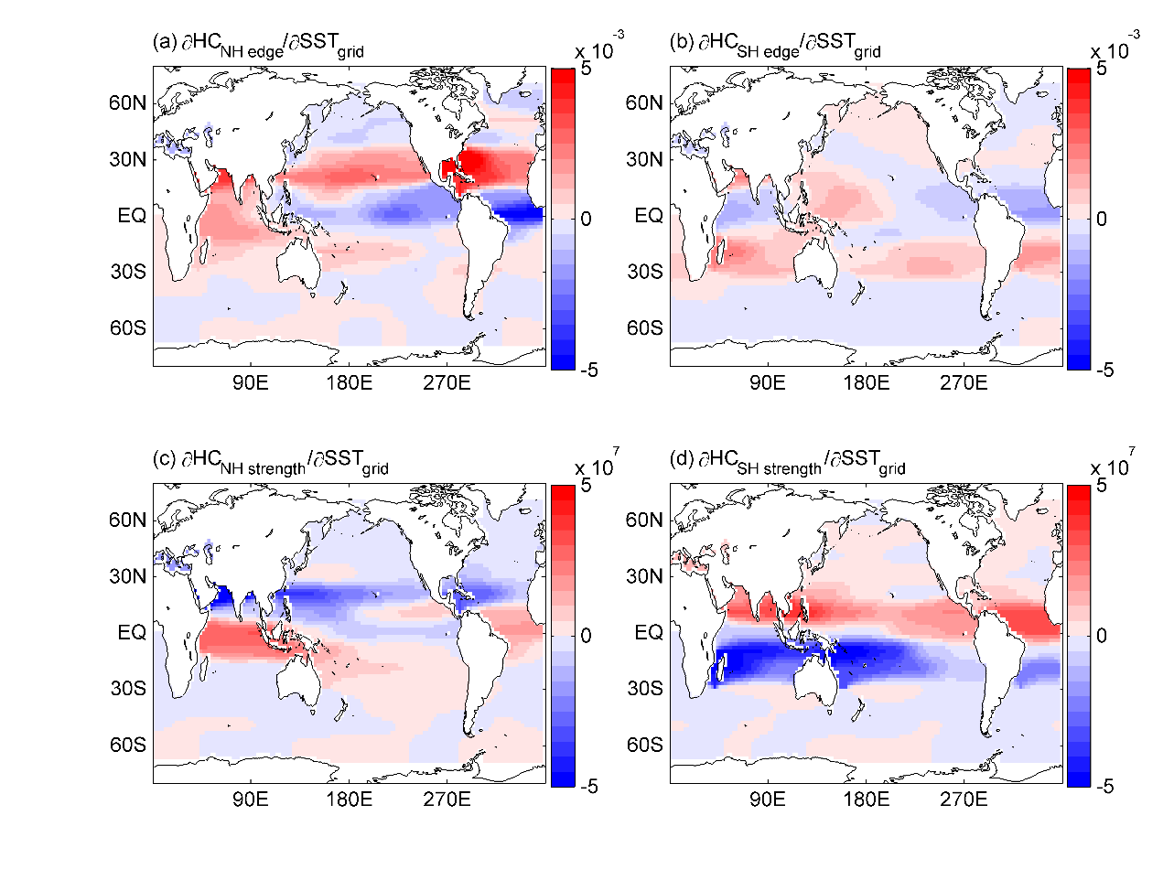
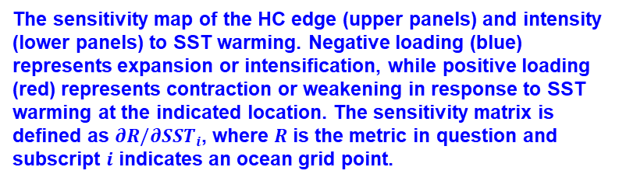
Response of the Hadley Circulation to Regional Sea Surface Temperature Changes
Objective
To systematically evaluate the sensitivity of the Hadley cell (HC) to global sea surface temperature (SST) using Green’s function-type perturbations.
Approach
Apply SST anomalies to 80 patches covering the global ocean.
Construct a sensitivity matrix of HC intensity and edge, making use of the 80 pairs of Green’s function experiments.
Predict the history of the Hadley circulation during 1980–2014, using the sensitivity matrix.
Impact
A holistic sensitivity map of HC to SST was constructed for the first time (see illustration on the right).
Subtropical SST warming was discovered to be most efficient in expanding HC; while the tropical Indian Ocean and Pacific Ocean can have a distinct impact on the HC edge through stationary wave response.
The sensitivity matrix captured the trend of HC expansion during 1980–2014 and attributed it mostly to the pattern of the SST trend.
The sensitivity map of the HC edge (upper panels) and intensity (lower panels) to SST warming. Negative loading (blue) represents expansion or intensification, while positive loading (red) represents contraction or weakening in response to SST warming at the indicated location. The sensitivity matrix is defined as $∂R/∂{SST}_{i}$, where $R$ is the metric in question and subscript $i$ indicates an ocean grid point.
Zhou C, J Lu, Y Hu, and MD Zelinka. 2019. “Response of the Hadley circulation to regional sea surface temperature changes.” J Climate, https://doi.org/10.1175/JCLI-D-19-0315.1.
Notes:
http://www.pnnl.gov/science/highlights/highlights.asp?division=749

