Slide 1
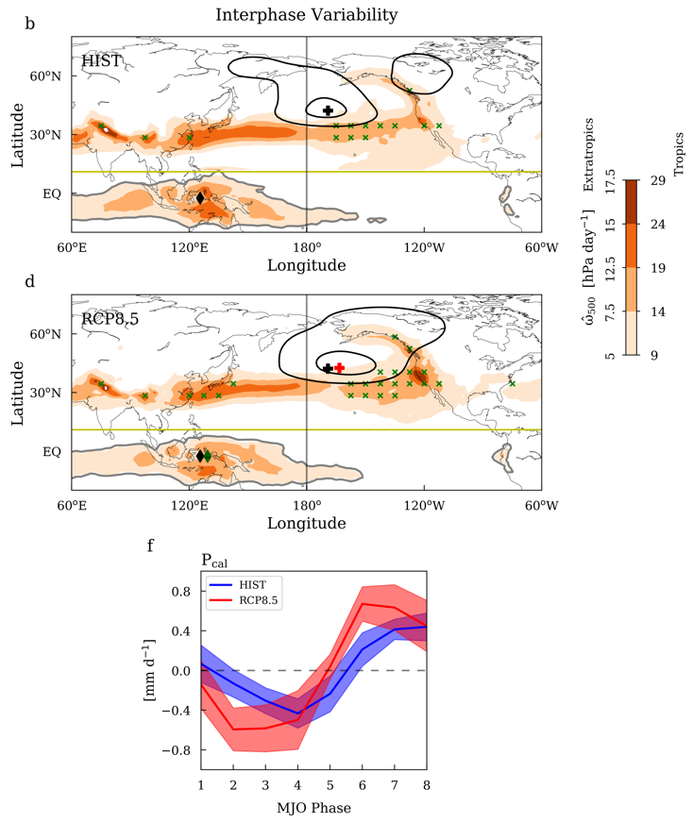
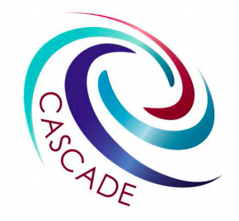
Amplified Madden-Julian Oscillation impacts in Pacific-North America region
The Madden-Julian Oscillation (MJO) creates teleconnections with far-reaching impacts on extratropical weather, but not much is known about potential changes in MJO teleconnections. Here we show that the MJO teleconnection pattern in boreal winter will likely extend further eastward over the North Pacific, leading to amplified impacts in California.
The eastward-extended teleconnection allows the MJO to exert a larger impact in the Northeast Pacific and along the west coast of North America. The enhanced subseasonal variability poses acute challenges on regional resource management and extreme weather preparation.
Selected GCMs that properly simulate MJO
MJO diagnosis based on multivariable MJO indices and phase composite
Linear baroclinic model for understanding the mechanisms underlying the eastward-extended MJO teleconnection
Citation: Zhou, W., Yang, D., Xie, S-P & Ma J. (2019). Amplified Madden-Julian Oscillation impacts in Pacific-North America region. Nature Climate Change https://doi.org/10.1038/s41558-020-0814-0

