Slide 1




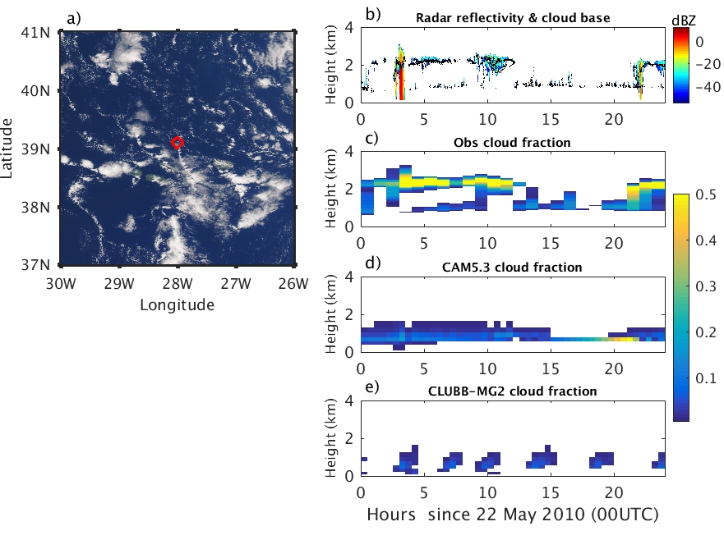
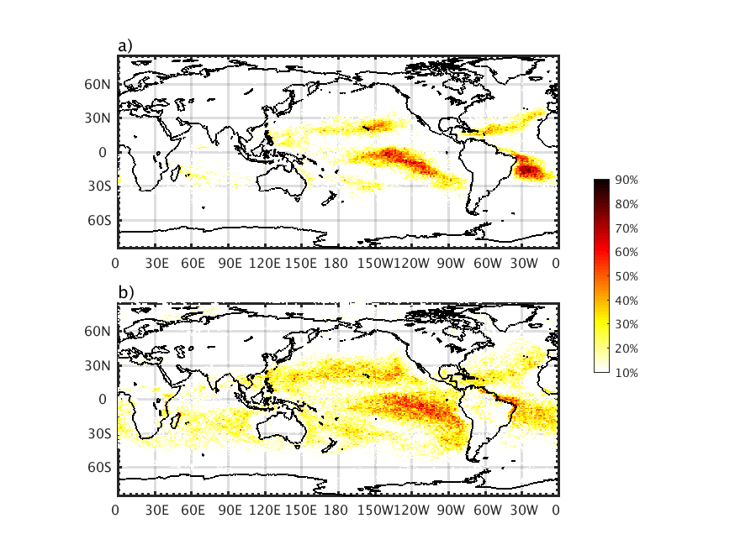
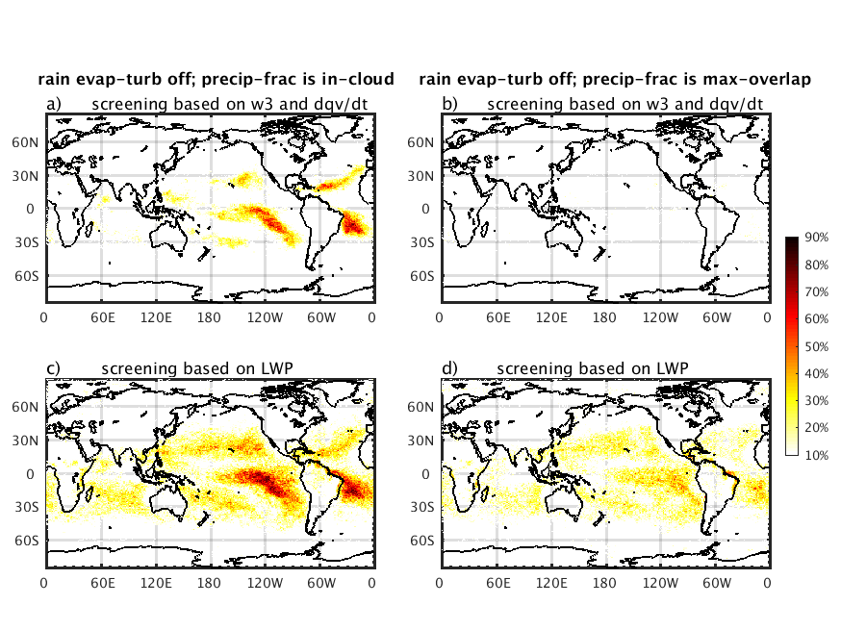
A newly identified cloud oscillation in atmospheric model simulations
Science Question
How common is the newly identified cloud oscillation in CAM simulations with CLUBB and MG2 schemes?
What causes this oscillation and how to control this oscillation?
Key Accomplishments
Uncovered properties and causes of a cloud oscillation common to marine cumulus clouds in atmospheric model simulations
This oscillation is caused by deficiencies in the coupling of turbulence with precipitation
Reported on the physically-consistent changes to model formulations that can effectively control the oscillation.
Azores
ARM observation
Model simulation
A regular cloud oscillation
Global occurrence of the oscillation
Original model setting
This process-level study helps uncover issues with coupling between parameterizations in atmospheric model simulations
Proposed model changes
Zheng, X., Klein, S. A., Ma, H.-Y., Caldwell, P., Larson, V. E., Gettelman, A. and Bogenschutz, P. (2017), A cloudy planetary boundary layer oscillation arising from the coupling of turbulence with precipitation in climate simulations. J. Adv. Model. Earth Syst., 9, doi:10.1002/2017MS000993
The oscillation is significantly reduced
Notes:
Model: The Community Atmosphere Model (CAM)
Parametrization schemes: Cloud Layers Unified By Binormals scheme (CLUBB) and an updated microphysics (MG2) scheme
The model simulation shown in top panel is a CAPT simulation
The global occurrence of the oscillation is calculated with the model high-frequency output from a one-month AMIP simulation during November, 2010.

