Slide 1
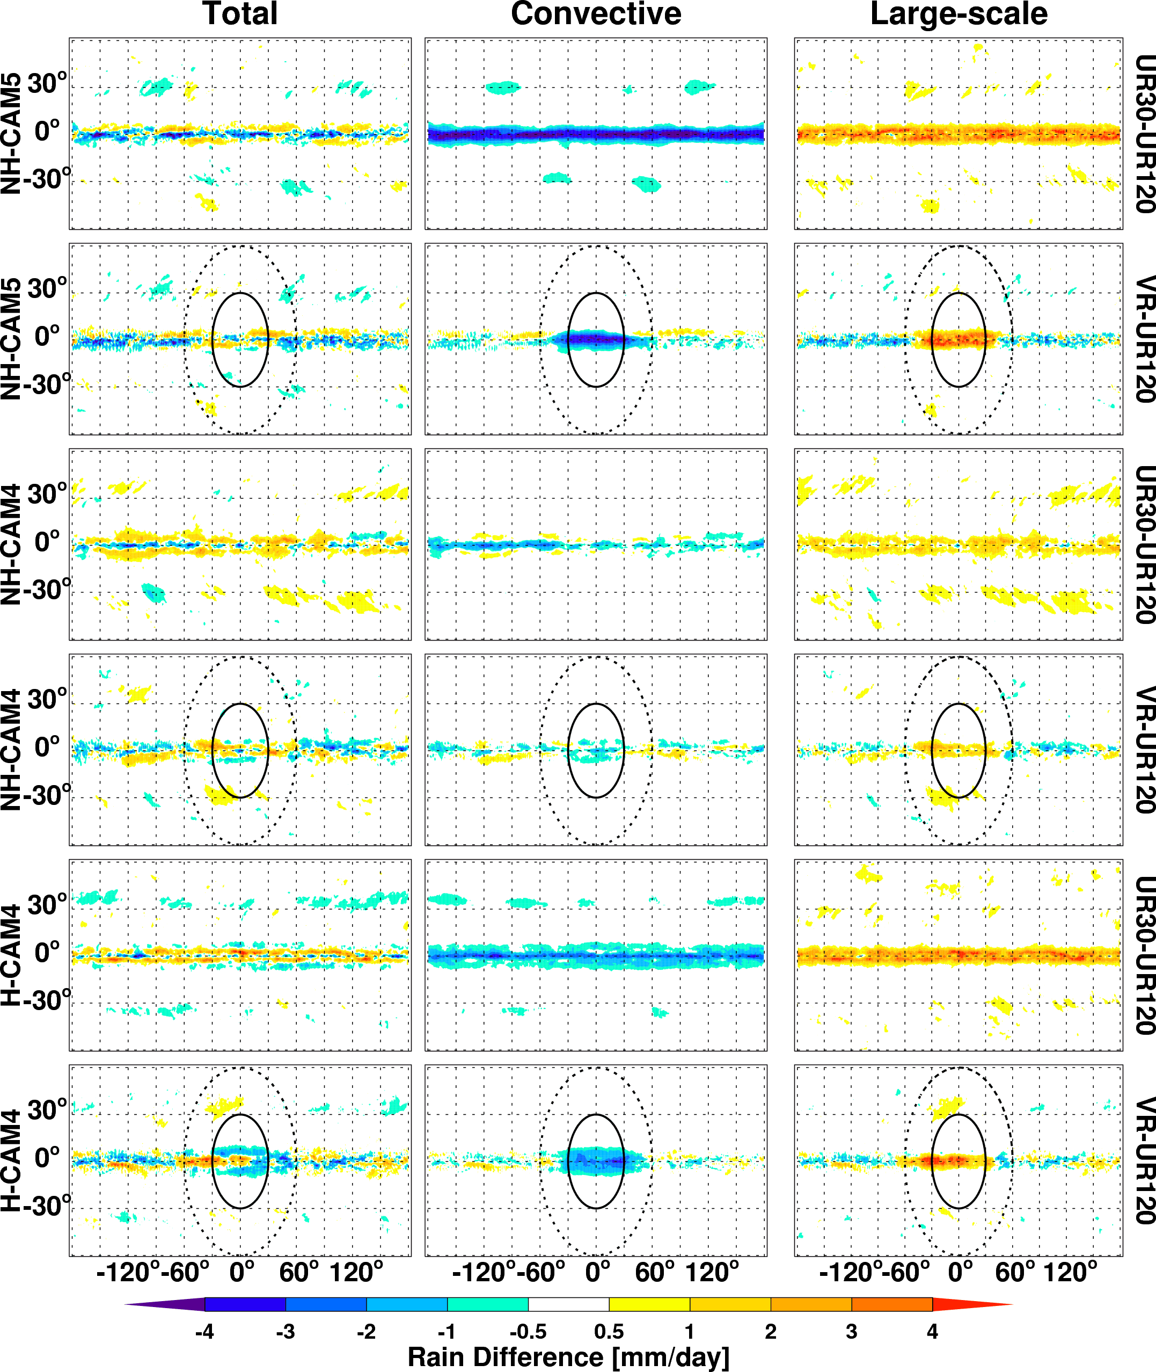
Exploring the Impacts of Physics and Resolution on Aqua-planet Simulations from a Non-hydrostatic Global Variable-resolution Modeling Framework
Objective
Investigate the sensitivity of a non-hydrostatic global variable resolution model (NH-MPAS) to model resolution and physics representations
Compare the NH-MPAS sensitivity to that of the hydrostatic model (H-MPAS)
Approach
Conduct a series of aqua-planet simulations at global quasi-uniform resolutions and global variable resolution with a regional mesh refinement over the tropics
Analyze the distinct characteristics of NH-MPAS in simulating precipitation, clouds, and large-scale circulation features compared to H-MPAS
The difference in averaged total, parameterized convective, and resolved large-scale precipitation between the MPAS simulations at UR 30 km (UR30) and 120 km (UR120) resolutions and between the VR 30->120 km (VR) and UR120 resolutions with CAM4 and CAM5 physics.
Impact
Demonstrated that the non-hydrostatic model has a lower resolution sensitivity compared to the hydrostatic model
The non-hydrostatic global variable resolution (NH-MPAS) model could be a viable approach for very high resolution climate modeling
Zhao C, LR Leung, S Park, S Hagos, J Lu, K Sakaguchi, J-H Yoon, BE Harrop, W Skamarock, M Duda. 2016. “Exploring the Impacts of Physics and Resolution on Aqua-planet Simulations from a Non-hydrostatic Global Variable-resolution Modeling Framework.” Journal of Advances in Modeling Earth Systems 8. DOI:10.1002/2016MS000727.
Notes:
http://www.pnnl.gov/science/highlights/highlights.asp?division=749

