Slide 1
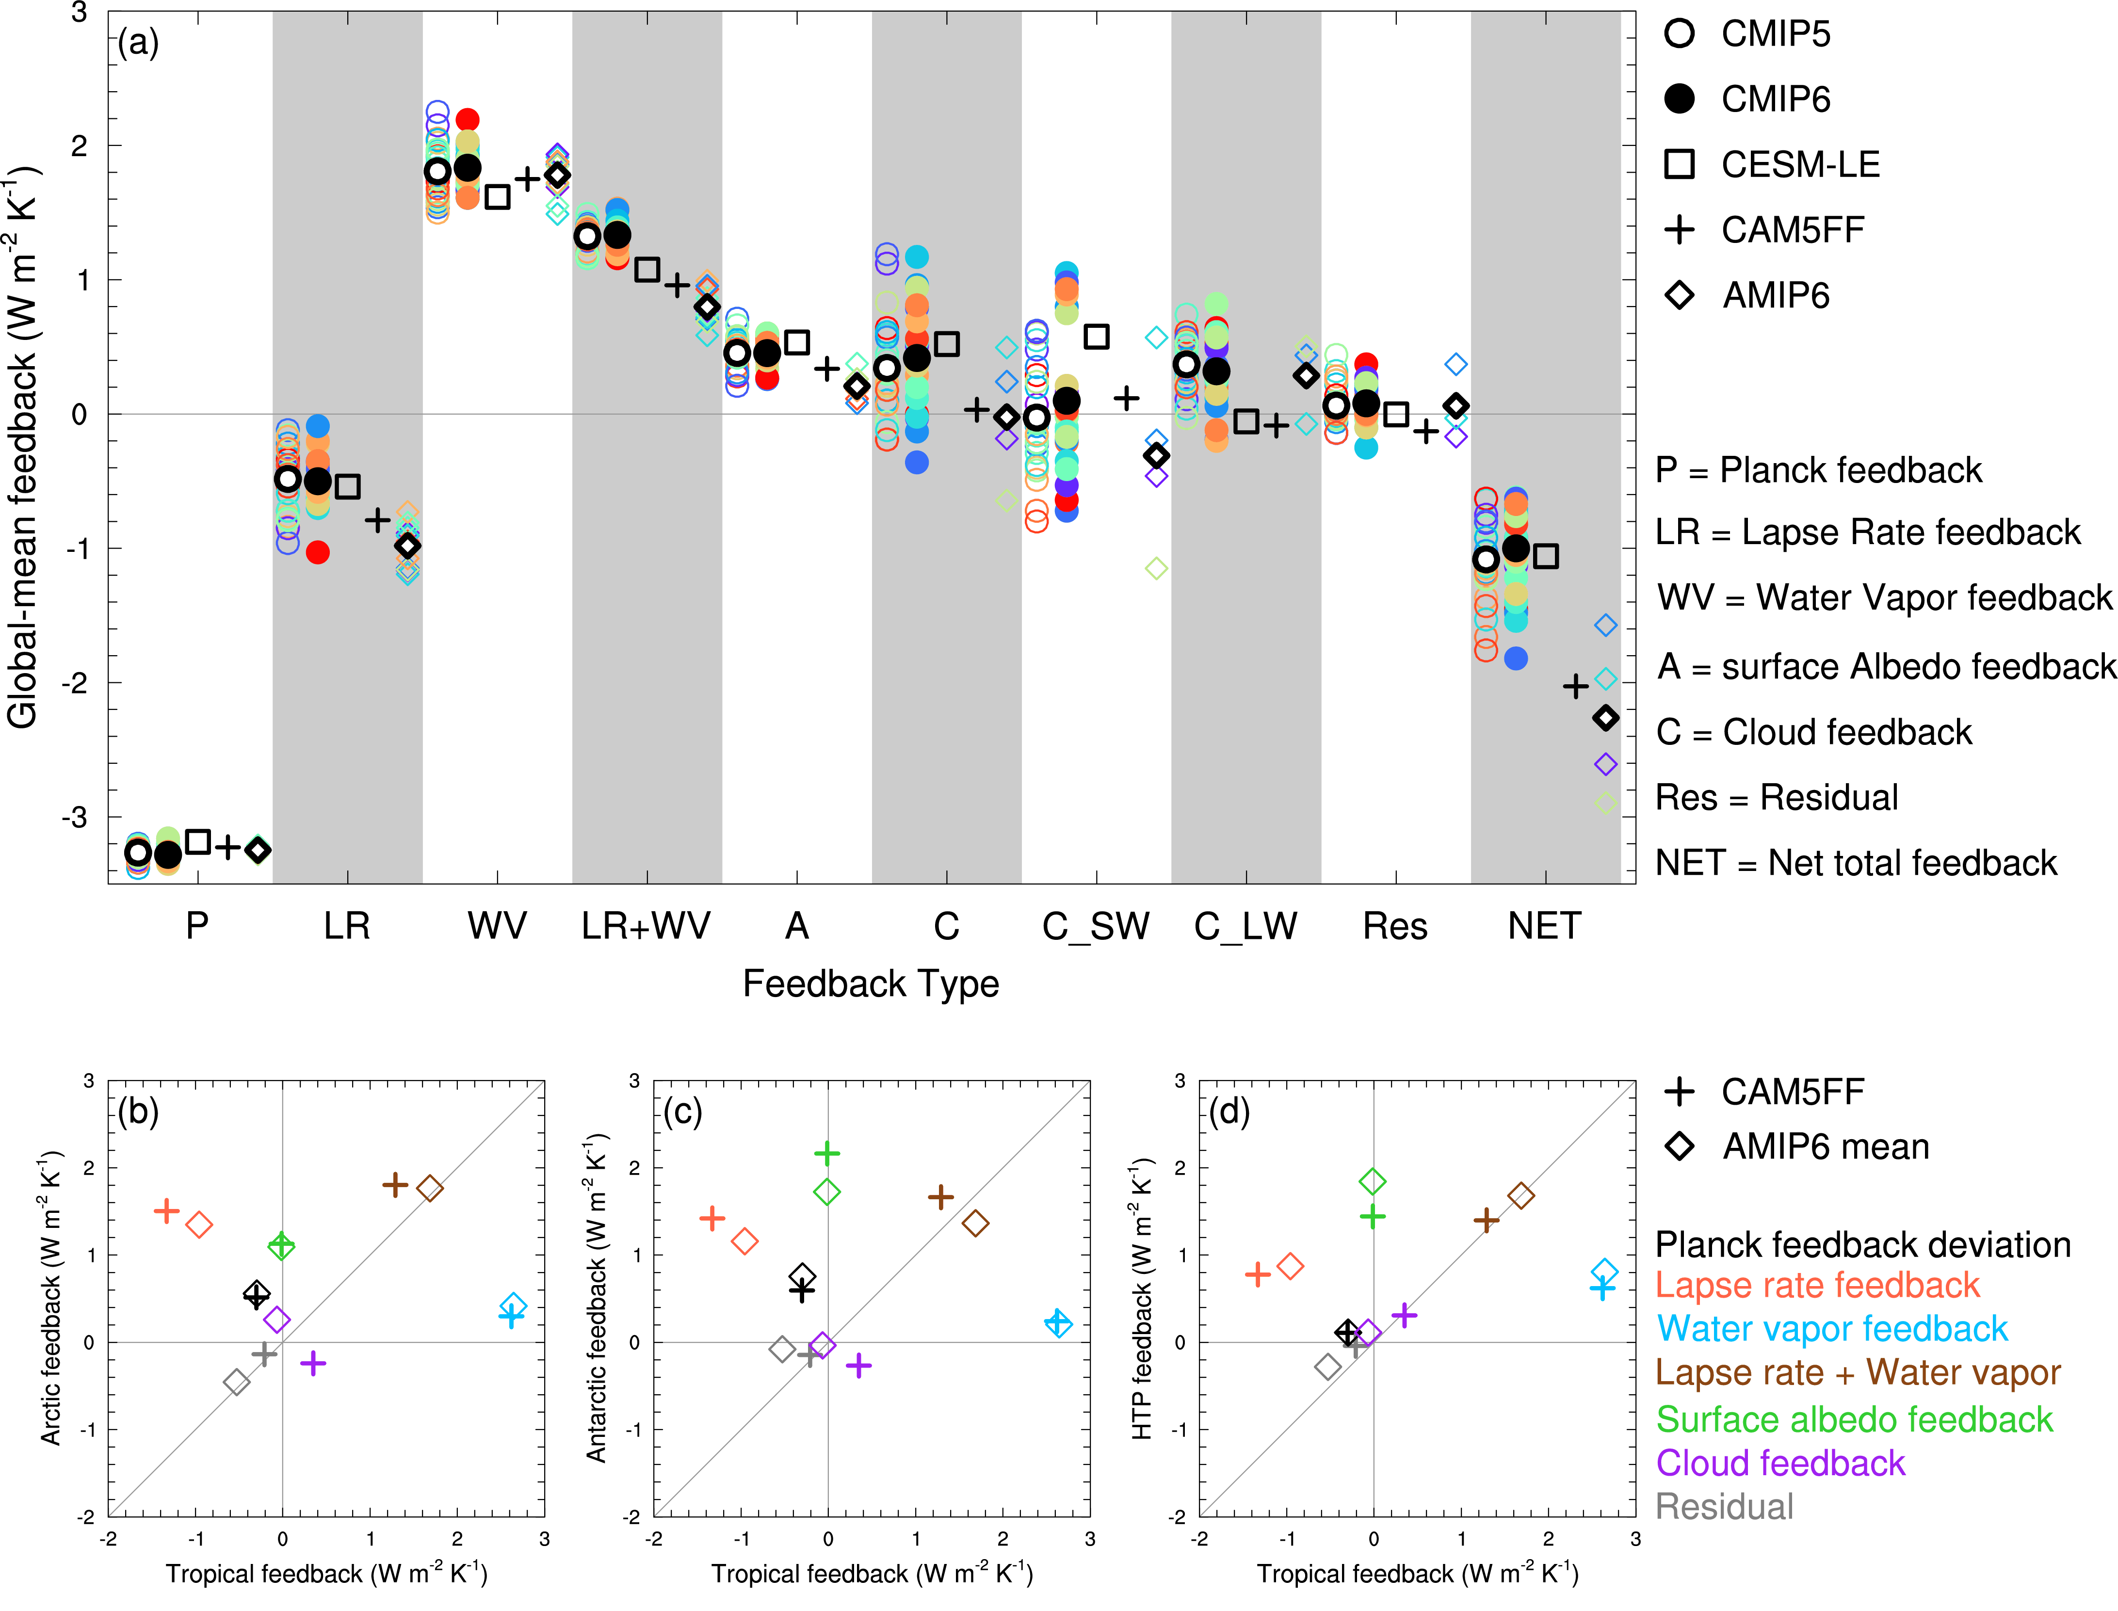
How Have Local Radiative Feedbacks Contributed to Polar Amplification since 1980?
Objective
Quantify global and local feedbacks over the three poles (Arctic, Antarctic, and Tibetan Plateau) to assess their contributions to polar amplification
Evaluate the kernel method for radiative feedback calculations with respect to historical short-term climate variations
Approach
Perform an atmospheric simulation for 1980−2017 using CAM5FF
Calculate and compare individual radiative feedbacks using results from CAM5FF and AMIP6 simulations
Impact
Global feedback is -2 W m⁻² K⁻¹, about twice the feedback estimated for long-term warming (4xCO₂) experiments
Lapse rate feedback is the largest contributor to the amplified warming over the three poles since 1980, followed by surface albedo feedback and Planck feedback deviation from its global mean
Except for a higher surface albedo feedback in the Antarctic, other feedbacks are similar between the Arctic and Antarctic
(Top) Global-mean radiative feedbacks from short-term AGCM results and long-term coupled simulations compare favorably. (Bottom) Scatter plots of individual feedbacks over the tropics and the Arctic (left), Antarctic (middle), and Tibetan Plateau (right) quantify their individual contributions to polar amplification.
Zhang R, H Wang, Q Fu, and P J Rasch. 2020. “Assessing global and local radiative feedbacks based on AGCM simulations for 1980–2014/2017.” Geophysical Research Letters, 47:e2020GL088063.
DOI: 10.1029/2020GL088063
Notes:
http://www.pnnl.gov/science/highlights/highlights.asp?division=749

