Slide 1
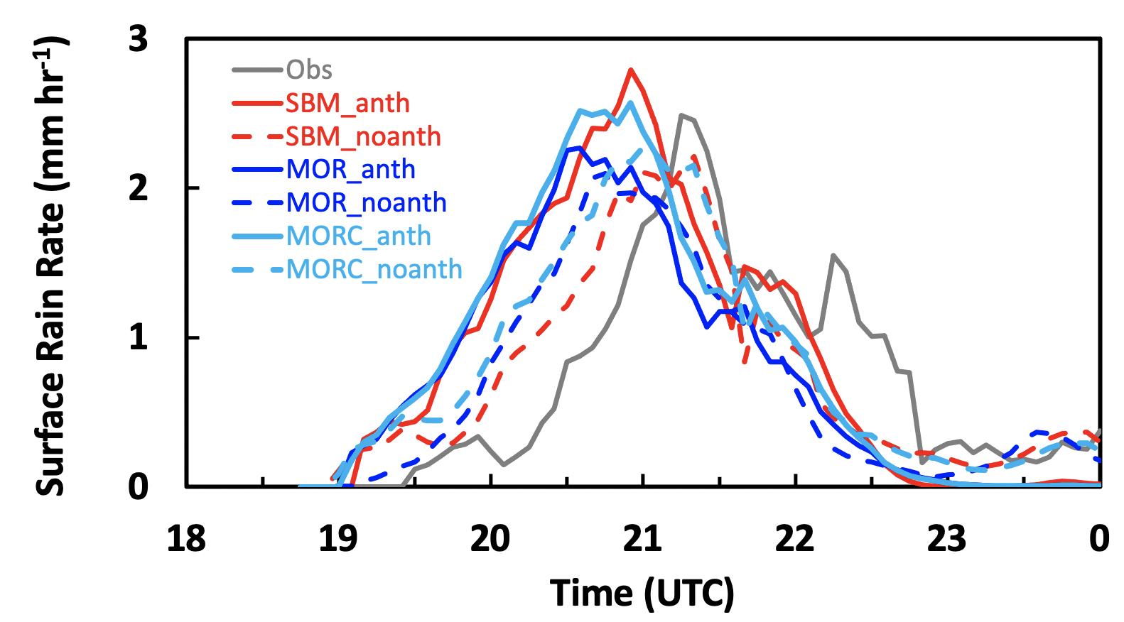
Better Modeling of Cloud Properties Shows Aerosol-Cloud-Interactions’ Influence on Convective Clouds
Objective
Understand how cloud microphysics parameterizations influence simulated anthropogenic aerosol effects on deep convective clouds in the Houston area.
Approach
Simulate a thunderstorm in the Houston area using the Weather Research and Forecast-Chemistry model at high resolution (0.5-km grid spacing).
Use observations to evaluate simulations of aerosol, radar reflectivity, and precipitation properties.
Carry out sensitivity tests of cloud models, comparing the results from a commonly used two moment bulk scheme and a physically-advanced bin scheme.
Impact
The physically-advanced bin scheme produces a simulated storm that matches observations well and shows a significant invigoration effect on the convective intensity and precipitation from anthropogenic aerosols.
The commonly-used two moment bulk scheme cannot simulate the invigoration effect because of the unphysical treatment of droplet condensation and evaporation processes.
The modified bulk scheme performed similarly to the bin scheme without adding computational time.
Time series of averaged surface rain rates from observation (grey), the physically-advanced bin scheme with (solid red) and without (red dash) aerosol effects, the commonly-used two moment scheme with (solid blue) and without (blue dash) aerosol effects, and the modified two moment scheme with (solid light blue) and without (light blue dash) aerosol effects. Aerosols enhanced precipitation intensity with the bin scheme but do not have notably affect the bulk scheme. The modified bulk scheme simulated a similar aerosol effect as the bin scheme.
Y. Zhang, J. Fan, Z. Li, and D. Rosenfeld. “Impacts of Cloud Microphysics Parameterizations on Simulated Aerosol-Cloud-Interactions for Deep Convective Clouds over Houston”, Atmos. Chem. Phys., 21, 2363–2381, (2021). [DOI: 10.5194/acp-21-2363-2021]

