Slide 1
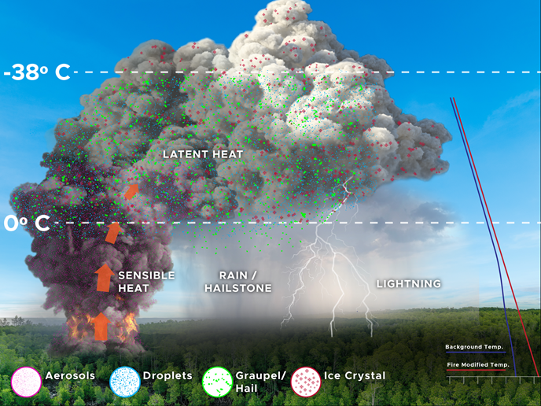
Wildfire Impact on Severe Convective Storms
Objective
Gain an understanding of how wildfire heat and aerosol effects contribute to storm severity such as hail and lightning
Build a computationally efficient model capability to forecast wildfire impacts on severe storms
Approach
Develop parameterization and apply the developed model to a pyrocumulonimbus event that produced hailstones and lightning
Carry out model sensitivity studies to understand the physical processes responsible for the observed wildfire impacts on storm severity
Impact
Developed a model to help forecast storm severity associated with wildfires
Discovered both the heat and aerosol emissions from wildfires invigorate the pyro-convection, enlarge hail size, and enhance lightning
Determined the heat released from fires plays a predominant role in triggering a strong storm but aerosols play a significant role in enhancing storm intensity, hail and lightning after the storm begins
A model that accounts for wildfire impacts on severe storms quantifies how heat and aerosols lead to the production of large hailstones and lightning
Zhang, Y., Fan, J., Logan, T., Li, Z., and Homeyer, C. R. (2019). Wildfire impact on environmental thermodynamics and severe convective storms. Geophysical Research Letters, 46, https://doi.org/10.1029/2019GL084534
Notes:
http://www.pnnl.gov/science/highlights/highlights.asp?division=749

