Slide 1
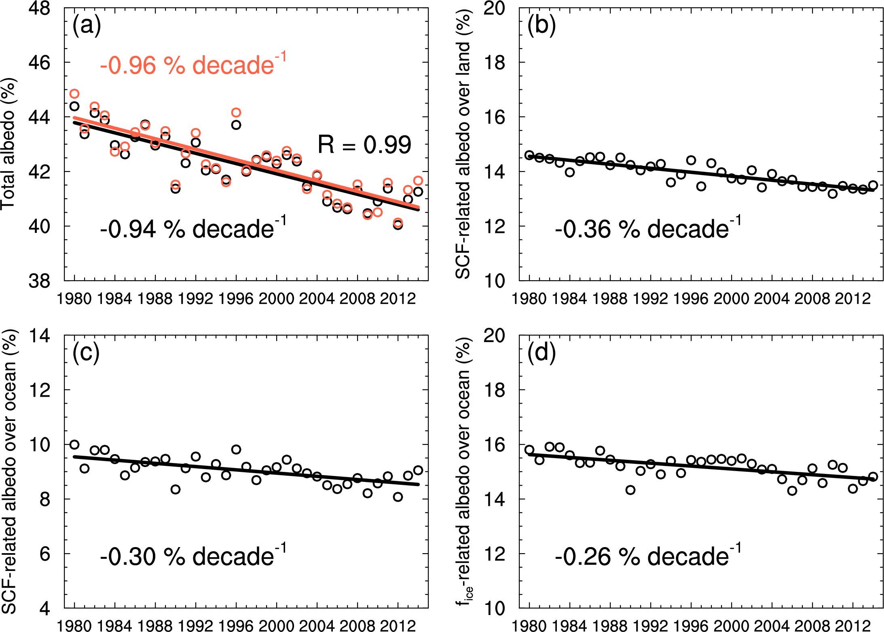
Recent Arctic Surface Albedo Reduction Explained
Objective
Explain significant reductions in reflection of sunlight observed in the Arctic since the 1980s
Approach
Document the reduction in albedo (which quantifies the refection of sunlight) in the Arctic, using satellite and other observations over the last 30 years
Show that an Earth System model can produce similar changes
Use the model and a novel trend attribution method to identify the factors explaining the albedo change
Impact
Found 70% of the satellite-observed reduction in the Arctic surface albedo since the 1980s is due to snow cover reductions over sea-ice and land
Identified that Arctic precipitation is increasing, but more of it is falling as rain, causing some of the decrease in snow cover and albedo (Warmer atmosphere and ocean temperatures may also contribute to snowmelt)
Identified light-absorbing soot in snow to not be a significant driver of change in the Arctic surface albedo, as soot deposition has decreased over the Arctic since the 1980s
Arctic annual-mean surface albedo trend during 1980-2014 (red line in panel a) and its attribution to three contributing factors: snow cover fraction (SCF) over land (panel b), SCF over the Arctic Ocean (panel c) and Arctic sea ice fraction (panel d)
Zhang R., H. Wang, Q. Fu, P.J. Rasch, and X. Wang. 2019. “Unraveling driving forces explaining significant reduction in satellite-inferred Arctic surface albedo since the 1980s.” Proc. Natl. Acad. Sci. U.S.A, Nov 11, 2019, https://doi.org/10.1073/pnas.1915258116
Notes:
http://www.pnnl.gov/science/highlights/highlights.asp?division=749

