Slide 1
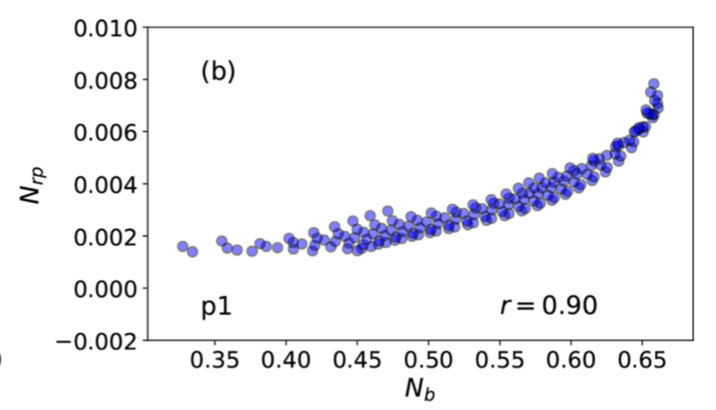
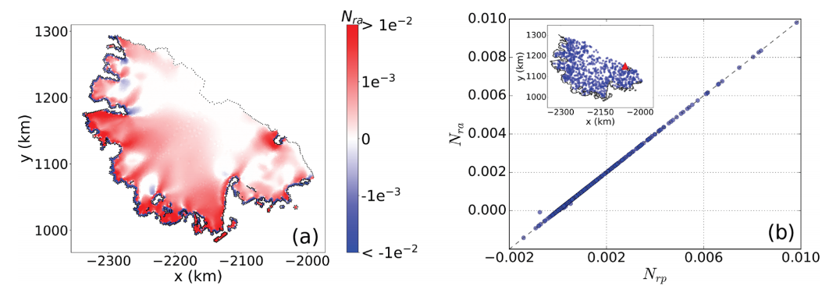
Diagnosing the sensitivity of grounding-line flux to changes in sub-ice-shelf melting
Scientific Achievement
Ice shelves provide resistance that limits the ice sheet flux across the grounding line and into the ocean; this “buttressing” is reduced by ice shelf thinning.
We investigate how commonly used measures of buttressing correlate with changes in grounding line flux (GLF) when the ice shelf is subjected to localized increases in sub-ice shelf melting.
While correlations between local buttressing and changes in GLF exist in some idealized configurations (right) they are generally weak for realistic ice shelves and a physical understanding for their cause remains elusive.
We thus argue against the use of local buttressing metrics for assessing GLF sensitivity to increased ice shelf melting.
As a robust alternative, we propose and demonstrate an adjoint-based approach.
Above: Correlation between the GLF number (vertical axis) and a commonly used measure of local ice shelf buttressing (horizontal axis) for an idealized ice shelf configuration.
Below: Adjoint-based sensitivity of GLF to sub-ice shelf melting for Larsen C ice shelf (left). Red indicates a relatively higher sensitivity: a relatively larger increase in GLF will result for a given increase in sub-ice shelf melting. The adjoint-based method gives nearly identical results to a point-by-point perturbation method (right) that is computationally much more costly.
Significance and Impact
GLF sensitivity diagnosed from the adjoint-based sensitivity is identical to that from pointwise, diagnostic model perturbation experiments (right).
The adjoint-based method provides an accurate assessement of GLF sensitivity and many-orders-of- magnitude savings in computational costs.
Zhang, T. et al., Diagnosing the sensitivity of grounding-line flux to changes in sub-ice-shelf melting, The Cryosphere, 14, https://doi.org/10.5194/tc-14-3407-2020, 2020 (Contact: Steve Price, sprice@lanl.gov)

