Slide 1
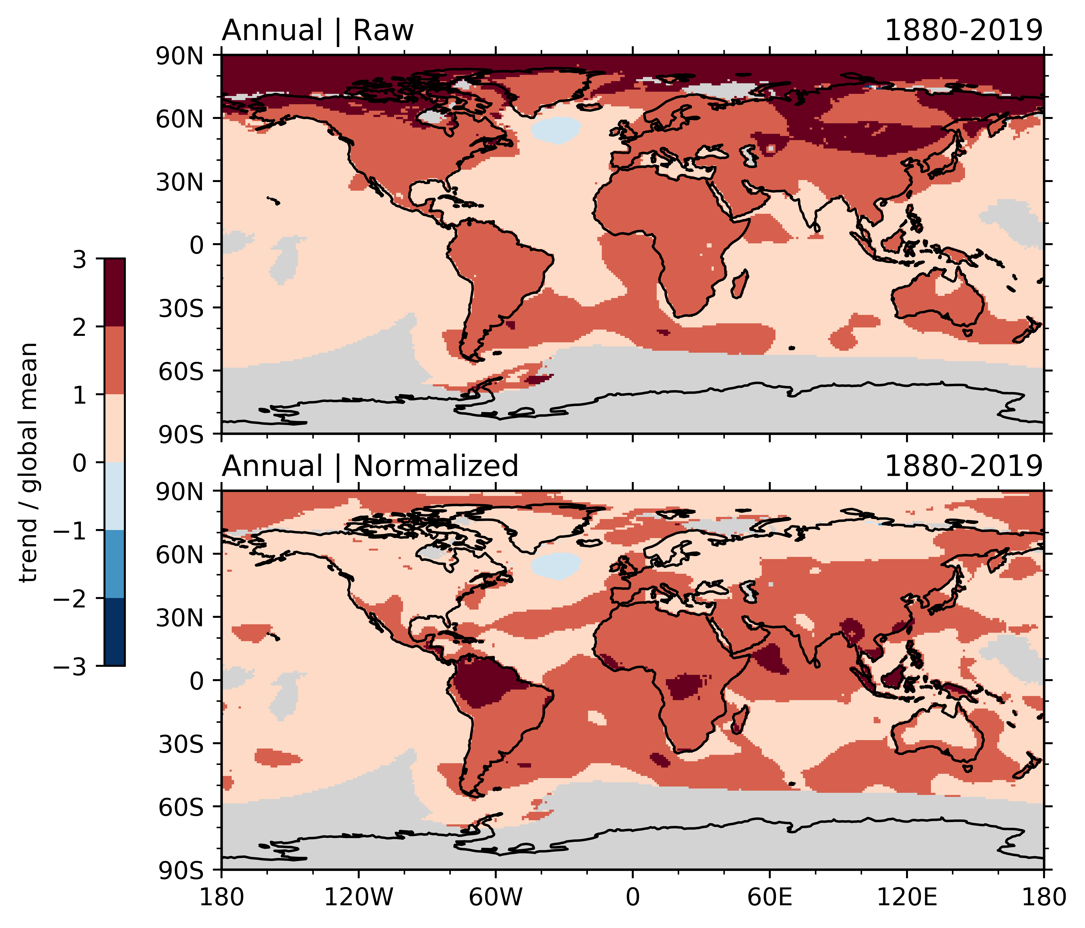

Quantifying the occurrence of record hot years through normalized warming trends
Zeng, Reeves Eyre, Dixon, and Arevalo
Motivation: Surface air temperature trends and extreme hot events are of global concern and they are related at a given location. However, it remains unknown whether this dependence is relevant to the comparison of extreme hot event occurrences over different regions.
Key Points: Based on observational data, 17 CMIP5 models and 15 CMIP6 models (including E3SM-1-0 and E3SM-1-1),
Compared with the raw trends showing Arctic amplification, the normalized trends show a tropical amplification over land (see Figure)
Occurrence of record hot years in different latitudes is better correlated with normalized, rather than raw, temperature trends
Earth system models’ correlations between normalized trends and record-breaking events are as high over land as over ocean, unlike in observations
Top: observed annual mean temperature trends from 1880 to 2019, expressed as a ratio to the global mean trend; and bottom: same as Top but for normalized trends.
Zeng, X., J.E.J. Reeves Eyre, R.D. Dixon, and J. Arevalo, 2021: Quantifying the occurrence of record hot years through normalized warming trends. Geophys. Res. Lett., 48, e2020GL091626, doi: 10.1029/2020GL091626
Broader impacts: University news release on 6/2/2021 (https://news.arizona.edu/story/record-breaking-temperatures-more-likely-populated-tropics); Featured on the front page of World Economic Forum (https://www.weforum.org/agenda/2021/06/tropics-record-breaking-temperatures-climate-change-environment); selected as "AMS News You Can Use" and “AGU in the News.”

