Slide 1

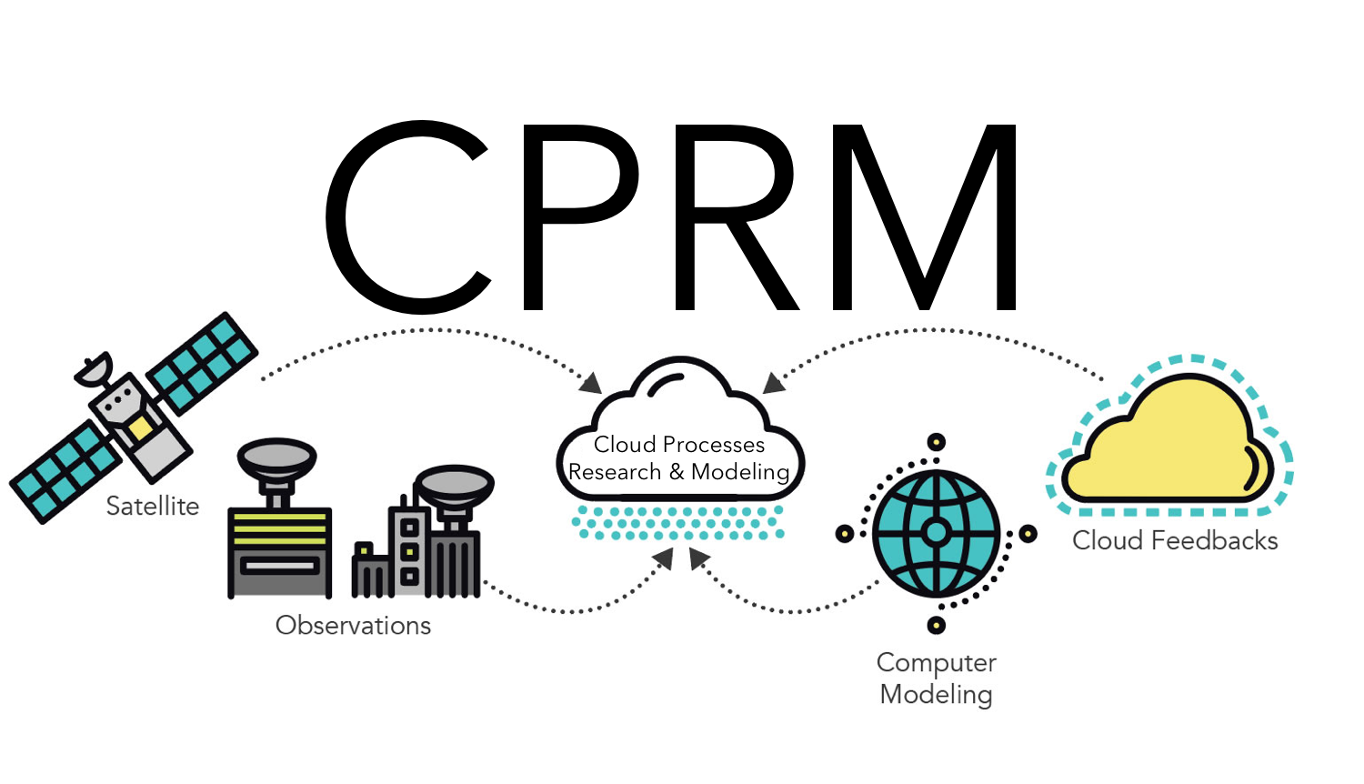
Drivers of Low Cloud Responses
to Poleward Jet Shifts in
Observations & Models
Scientific Achievement
Observed poleward shifts of the midlatitude jet stream do not cause substantial changes in total cloud cover or top-of-atmosphere radiation on interannual timescales. Whereas upper-level clouds shift poleward with the jet, low clouds increase dramatically across much of the North Pacific. This increase is primarily due to enhanced cold air advection. Global climate models largely fail to capture the observed responses of clouds & radiation to interannual jet shifts because they systematically underestimate how sensitive low clouds are to their environmental controls.
Significance & Impact
This work indicates that observed jet shifts do not cause reductions in total cloud cover, primarily because the environment in the region vacated by the jet becomes highly favorable for low clouds. Models systematically underestimate the observed increase in low clouds with cold advection, preventing them from capturing the observed insensitivity of cloud-radiative effects to jet shifts. The results suggest that jet shifts – in and of themselves – are not capable of causing substantial cloud feedbacks, in contrast to common expectations.
Response of low cloud cover (shading) and surface temperature advection (contours) to a 1° poleward jet shift from 8 satellite datasets.
Research Details
The authors use a suite of satellite observations to assess the cloud response to jet shifts and use a multiple linear regression model to attribute their responses to various environmental controls. Doing the same across an ensemble of GCMs highlights systematic biases in how sensitive modeled clouds are to their environment.
Zelinka, M. D., K. M. Grise, S. A. Klein, C. Zhou, A. M. DeAngelis, and M. W. Christensen, Drivers of the Low Cloud Response to Poleward Jet Shifts in the North Pacific in Observations and Models, J. Climate, in press (2018).
Notes:
The Science
Scientists in the Cloud Processes Research and Modeling Group at Lawrence Livermore National Laboratory, with colleagues at University of Virginia, UCLA, and University of Oxford have determined the drivers of observed cloud responses to poleward jet shifts in the North Pacific. They find that whereas upper-level clouds shift poleward with the jet on interannual timescales, low clouds increase dramatically across much of the North Pacific, resulting in very little change in total cloud cover and hence very little change in top-of-atmosphere radiation. This low cloud increase is consistent across eight independent satellite-derived cloud products and was shown to be primarily caused by enhanced cold air advection and (less so) by increased low-level stability. Global climate models largely fail to capture the observed responses of clouds and radiation to interannual jet shifts because they systematically underestimate how sensitive low clouds are to these environmental controls.
The Impact
Many climate model simulations of global warming predict a large positive cloud feedback at midlatitudes that is often attributed to the poleward shift of the jet. This work indicates that jet shifts in nature do not cause reductions in total cloud cover, primarily because the environment in the region vacated by the jet becomes highly favorable for low clouds. Moreover, models systematically underestimate the observed increase in low clouds with cold advection, highlighting an important model bias that will have direct implications for the ability of models to capture the observed insensitivity of cloud-radiative effects to jet shifts. How these biases translate to the climate change response of midlatitude clouds is an important topic of future work, but the results suggest that jet shifts – in and of themselves – are not capable of causing substantial cloud feedbacks.
Summary
The long-standing expectation that poleward shifts of the midlatitude jet under global warming will lead to poleward shifts of clouds and a positive radiative feedback on the climate system has been shown to be misguided by several recent studies. On interannual timescales, free tropospheric clouds are observed to shift along with the jet, but low clouds increase across a broad expanse of the North Pacific Ocean basin, resulting in negligible changes in total cloud fraction and top-of-atmosphere radiation. Here it is shown that this low cloud response is consistent across eight independent satellite-derived cloud products. Using multiple linear regression, it is demonstrated that the spatial pattern and magnitude of the low cloud coverage response is primarily driven by anomalous surface temperature advection. In the Eastern North Pacific, anomalous cold advection by anomalous northerly surface winds enhances sensible and latent heat fluxes from the ocean into the boundary layer, resulting in large increases in low cloud coverage. Local increases in low-level stability make a smaller contribution to this low cloud increase. Despite closely capturing the observed response of large-scale meteorology to jet shifts, global climate models largely fail to capture the observed response of clouds and radiation to interannual jet shifts because they systematically underestimate how sensitive low clouds are to surface temperature advection, and to a lesser extent, low-level stability. More realistic model simulations of cloud-radiation-jet interactions require that parameterizations more accurately capture the sensitivity of low clouds to surface temperature advection.

