Slide 1
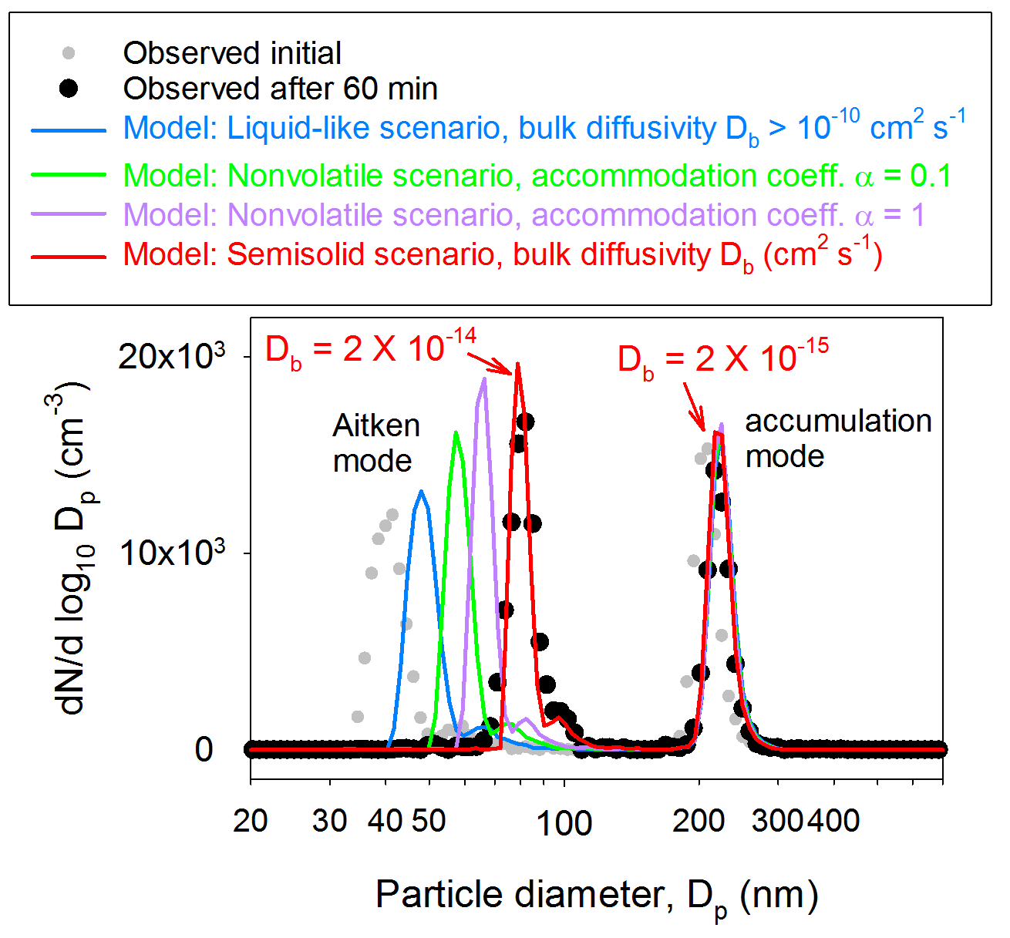
How Some Aerosols Transform from Atmospheric Bystanders into Climate Actors
Objective
Investigate the effect of low bulk diffusivity in viscous organic particles on the size-dependent growth kinetics of secondary organic aerosol (SOA) formation
Approach
Observe growth kinetics of SOA formation in an environmental chamber from photooxidation of isoprene in the presence of preexisting Aitken mode (ammonium sulfate) and accumulation mode (isoprene or α-pinene SOA) aerosol
Observe evaporation kinetics of size-selected isoprene SOA in a separate small chamber
Impact
Data analyses show SOA formation under relatively dry conditions may favor growth of small particles at the expense of larger ones
Results enable a more accurate representation of a SOA formation mechanism to simulate growth of ultrafine particles to climatically active sizes in atmospheric models, thus improving simulated aerosol radiative effects on climate
Comparison of the observed and modeled aerosol size distribution evolution due to isoprene SOA formation in the presence of preexisting Aitken mode (ammonium sulfate) and accumulation mode (isoprene SOA) aerosol.
Zaveri RA, JE Shilling, A Zelenyuk, J Liu, DM Bell, EL D’Ambro, CJ Gaston, JA Thornton, A Laskin, P Lin, J Wilson, RC Easter, J Wang, AK Bertram, ST Martin, JH Seinfeld, and DR Worsnop. 2018. “Growth Kinetics and Size Distribution Dynamics of Viscous Secondary Organic Aerosol.” Environmental Science & Technology 52:1191-1199. DOI: 10.1021/acs.est.7b04623
Notes:
How Some Aerosols Transform from Atmospheric Bystanders into Climate Actors
New research improves the understanding of how ultrafine particles in the atmosphere grow into climatically active sizes.
The Science
The dynamics of aerosol growth and size distribution evolution, and how they affect Earth’s climate, are poorly understood. New research on secondary organic aerosols formed from oxidation of isoprene—a volatile organic compound released from many plants and trees—provided quantitative insights into the effects of slow diffusion inside viscous organic particles on their growth kinetics. A research team led by Pacific Northwest National Laboratory scientists discovered that bulk diffusion-limited partitioning of semivolatile organic compounds into large viscous organic particles effectively promotes the growth of smaller particles that have shorter diffusion timescales.
The Impact
Physicochemical processes governing secondary organic aerosol formation are more complex than atmospheric models currently represent. The results of this study will enable more accurate predictions of secondary organic aerosol formation by including a better representation of the growth of ultrafine aerosol particles to climatically active sizes in atmospheric models. This will improve simulations of how aerosols affect Earth’s energy balance.
Summary
Secondary organic aerosols (SOAs) in the atmosphere are produced when oxidation products from volatile organic compounds condense from the gas phase to the particle phase. These SOAs constitute a major fraction of the submicron aerosol in Earth’s atmosphere, and they play a crucial role in the growth of ultrafine particles to sizes larger than ~80 nanometers. At this size, the particles begin to efficiently scatter light and can activate as cloud condensation nuclei. Under dry to moderate relative humidity, SOAs can be highly viscous such that slow diffusion of condensing compounds inside these semisolid particles can prolong the gas-particle equilibration timescale. Researchers investigated the effects of low bulk diffusivity on the growth and evaporation kinetics of SOAs formed in PNNL’s environmental chamber from photooxidation of isoprene. Mass spectrometric analysis was performed using the FIGAERO-CIMS of the University of Washington and the nanoDESI and miniSPLAT II of EMSL, the Environmental Molecular Sciences Laboratory, an Office of Science user facility. The researchers found that isoprene SOA was composed of several semivolatile organic compounds, with some reversibly reacting to form high molecular weight compounds called oligomers. Model analysis revealed that hindered partitioning of semivolatile organic compounds into large viscous particles is responsible for the observed growth of the smaller particles that have shorter diffusion timescales. This effect has important implications for the growth of atmospheric ultrafine particles to climatically active particles via SOA formation under relatively dry conditions.

