Slide 1
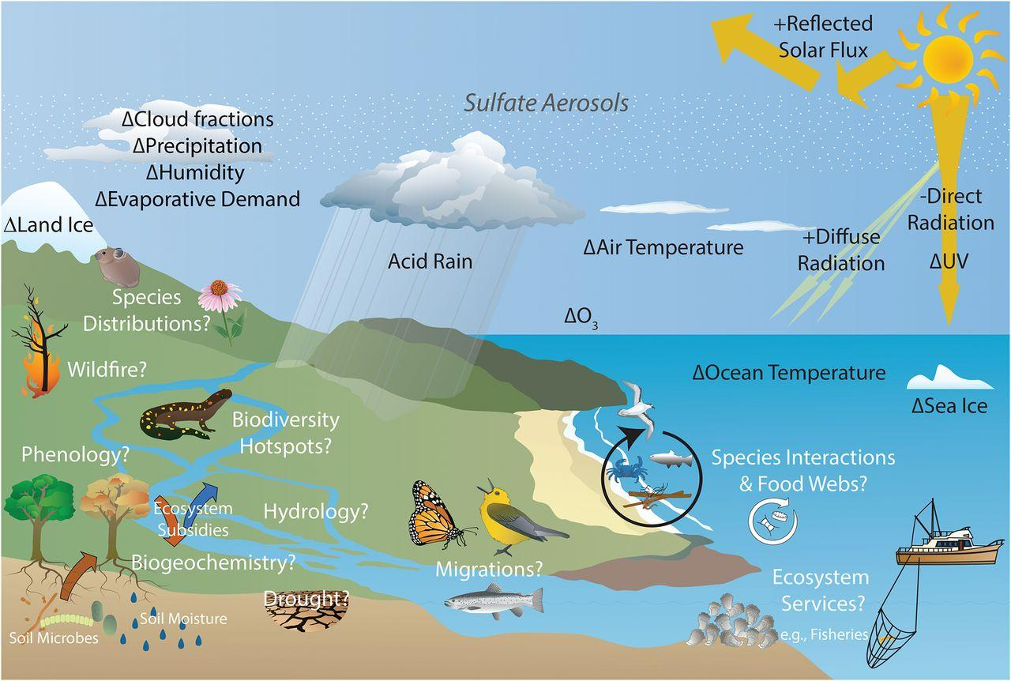
Research Priorities for Studying Ecological Impacts of Geoengineering
Objective: To suggest that as climate intervention approaches receive increased attention, research about potential impacts on terrestrial and marine ecological systems is needed.
Approach: An interdisciplinary group composed of ecologists and atmospheric and climate scientists developed a review of existing studies and identified priorities for future research.
Results/Impacts: Climate effects of geoengineering approaches, including solar radiation modification (SRM), have been studied with models, but few studies have investigated impacts SRM would have on ecological systems. Since stratospheric aerosol intervention (SAI) is considered feasible, we outline current gaps in knowledge about potentially helpful and harmful predicted
Figure: The potential effects of stratospheric aerosol intervention (SAI) scenarios on terrestrial and marine ecological systems are largely unknown.
effects of SAI on ecological systems. Complex interactions between Earth’s climate system and living systems are described, and collaborative research focused on biodiversity and ecosystem services is encouraged.
Zarnetske, P. L., J. Gurevitch, J. Franklin, P. M. Groffman, C. S. Harrison, J. J. Hellmann, Forrest M. Hoffman, S. Kothari, A. Robock, S. Tilmes, D. Visioni, J. Wu, L. Xia, and Cheng-En Yang (2021), Potential Ecological Impacts of Climate Intervention by Reflecting Sunlight to Cool Earth, Proc. Nat. Acad. Sci., 118(15), e1921854118, doi:10.1073/pnas.1921854118.

