Slide 1
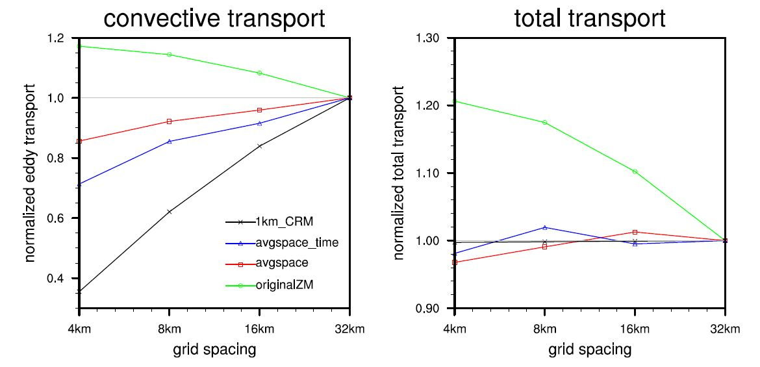
Reducing Resolution Dependence of Cloud and Precipitation Simulations in Climate Models
Objective
Reduce the dependence of simulated clouds and precipitation on model grid size
Approach
Average large-scale drivers of cumulus clouds in both space and time
Test the effect of averaging on simulated precipitation and moisture transport as a function of grid size in regional simulations
Use diagnostics to determine an explanation for the reduced resolution dependence
Impact
Mitigates “double counting” of resolved and parameterized vertical transport
New approach could make calibration of climate models at fine resolution much easier
This procedure can be applied to most cumulus cloud parameterizations
Averaging the large-scale environment reduces the dependence of total moisture transport on the model grid size.
Yun Y, J Fan, H Xiao, GJ Zhang, SJ Ghan, K-M Xu, P-L Ma, and WI Gustafson Jr. 2017. “Assessing the Resolution Adaptability of the Zhang-McFarlane Cumulus Parameterization with Spatial and Temporal Averaging.” Journal of Advances in Modeling Earth Systems 9. DOI: 10.1002/2017MS001035

