Slide 1
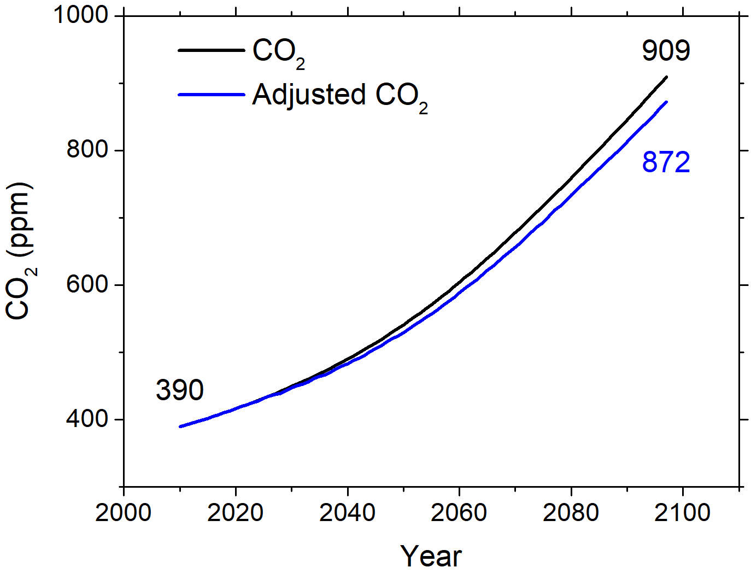
Geoengineering Increases the Global Land Carbon Sink
Objective: To examine stratospheric aerosol intervention (SAI) impacts on plant productivity and terrestrial biogeochemistry.
Approach: Analyze and compare simulation results from the Stratospheric Aerosol Geoengineering Large Ensemble (GLENS) project from 2010 to 2097 under RCP8.5 with and without SAI.
Results/Impacts: In this scenario, SAI causes terrestrial ecosystems to store an additional 79 Pg C globally as a result of lower ecosystem respiration and diminished disturbance effects by the end of the 21st century, yielding as much as a 4% reduction in atmospheric CO₂ mole fraction that progressively reduces the SAI effort required to stabilize surface temperature.
Yang, C.-E., F. M. Hoffman, D. M. Ricciuto, S. Tilmes, L. Xia, D. G. MacMartin, B. Kravitz, J. H. Richter, M. Mills, and J. S. Fu (2020), Assessing Terrestrial Biogeochemical Feedbacks in a Strategically Geoengineered Climate, Environ. Res. Lett., doi:10.1088/1748-9326/abacf7.
Figure: The larger sink under SAI increased land C storage by 79 Pg C by 2097, which would reduce the projected atmospheric CO₂ level.

