Slide 1
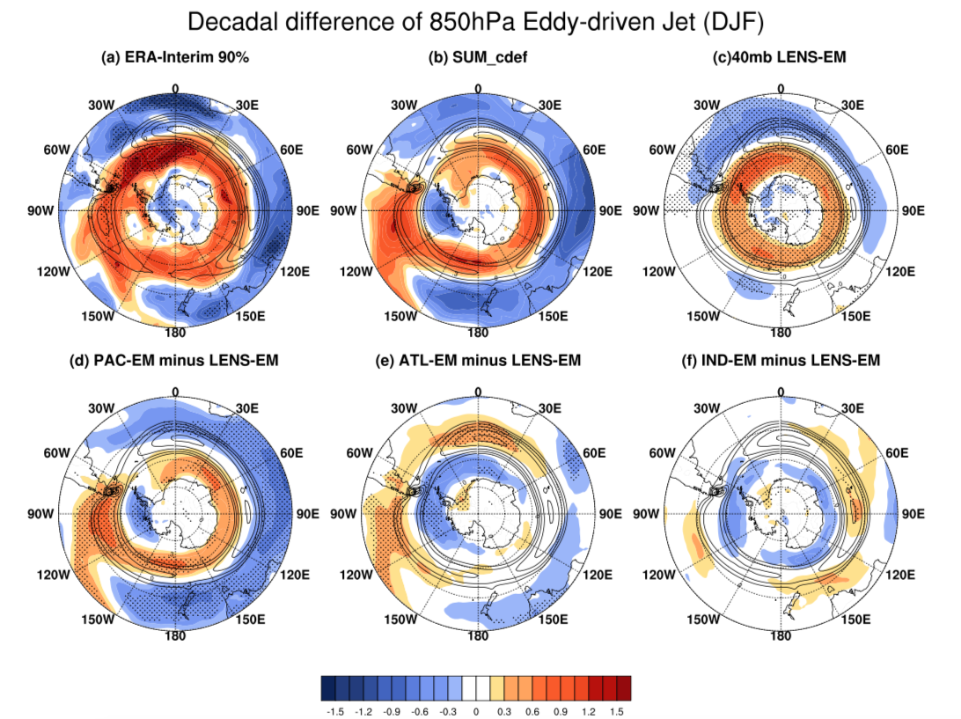


Role of tropical variability in driving decadal shifts in the Southern Hemisphere summertime eddy-driven jet
Objective: Determine the importance of tropical sea surface temperature variability in driving observed decadal shifts in the Southern Hemisphere summertime eddy-driven jet
Research:
--Examine the CESM1 pacemaker experiments where sea surface temperatures are nudged to observed anomalies in the tropical Pacific, tropical Indian and North Atlantic
--Identify dominant driver of decadal SH jet shift by isolating the role of external forcing from that of internally-driven sea surface temperatures
--Understand dynamical mechanism through transient eddy momentum flux convergence analysis
850 hPa zonal wind difference between 1999-2013 - 1979-1998 in (a) ERA-Interim reanalysis; (b) Sum of (c), (d), (e) and (f); (c) LENS external forcing; (d) Pacific pacemaker – LENS; (e) Atlantic pacemaker – LENS (f) Indian pacemaker – LENS. Solid contours indicate the climatological jet.
Impact: Results indicate the importance of the internally-driven tropical Pacific sea surface temperature variability in driving decadal shifts in the Southern Hemisphere westerly wind belt which has large impacts on the Southern Ocean and Antarctic sea-ice and ice sheets
Yang D., J.M. Arblaster, G.A. Meehl, M.H. England, E.-P. Lim, S. Bates, N. Rosenbloom, 2020, Role of tropical variability in driving decadal shifts in the Southern Hemisphere summertime eddy-driven jet, J Climate, https://doi.org/10.1175/JCLI-D-19-0604.1

