Slide 1
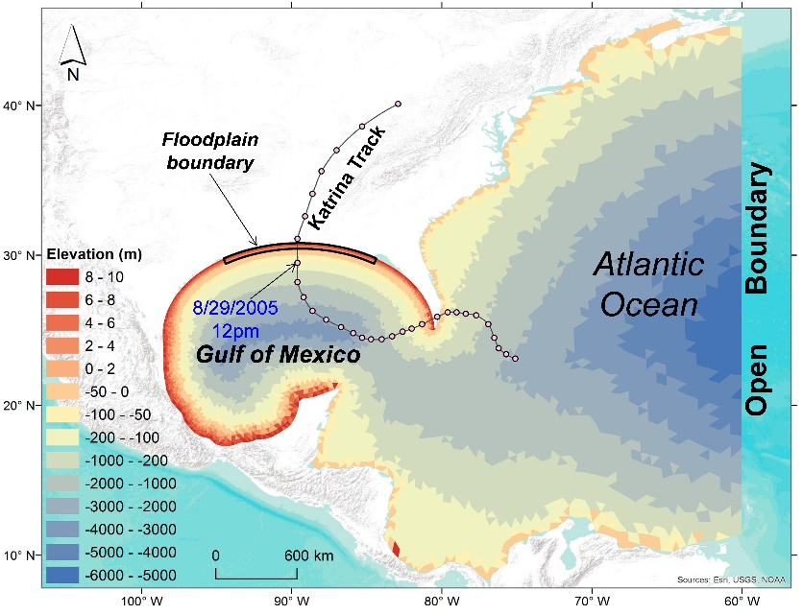
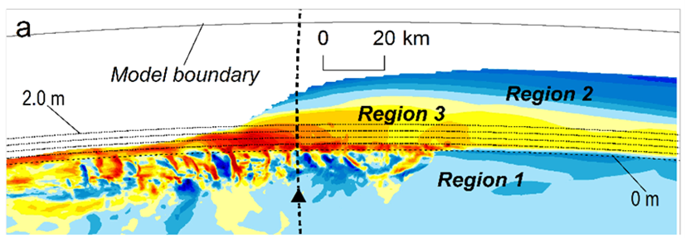
The Nonlinear Response of Storm Surge to Sea-Level Rise: A Modeling Approach
Objective
Quantify the spatial distribution of the nonlinear response of storm surge to sea-level rise for a specific hurricane event
Approach
Use FVCOM to evaluate the nonlinear response of storm surge to sea-level rise using a high-resolution model under five different sea-level rise scenarios ranging from zero to 2.0 meters
Force the model with the observed wind field from Hurricane Katrina, and evaluate changes in storm surge magnitude across three different regions: the offshore coastal area, the upper floodplain, and the lower floodplain
Impact
Specific portions of the coast may experience increases in storm surges that are even larger than the rate of sea-level rise, which is valuable information for assessing coastal infrastructure resilience.
(Top) Storm surge model domain; (Bottom) The nonlinear response of maximum surge height to 0.5-m sea-level rise indicated by the normalized nonlinearity (NNL) index.
Wang T and Z Yang. 2019. “The Nonlinear Response of Storm Surge to Sea-Level Rise: a Modeling Approach.” Journal of Coastal Research. DOI: 10.2112/JCOASTRES-D-18-00029.1
Notes:
http://www.pnnl.gov/science/highlights/highlights.asp?division=749

