Slide 1
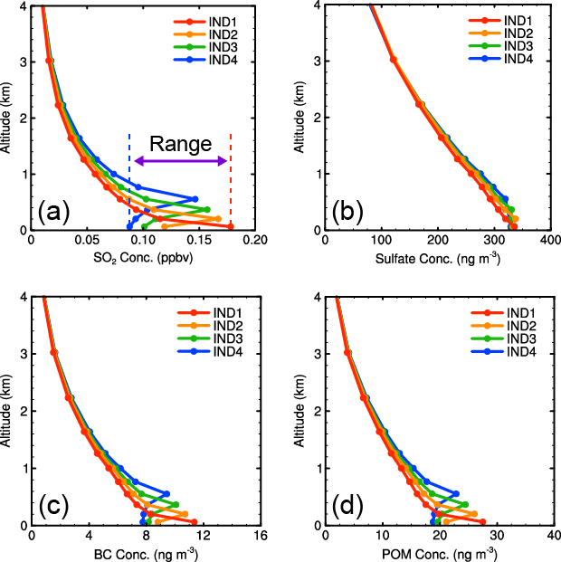
Impact of Emission Height Uncertainty on Aerosol Distribution
Objective
Examine the impact of anthropogenic emission injection height uncertainty on global sulfur dioxide (SO₂) and aerosol distributions in the atmosphere.
Approach
Perform a simulation with various assumptions for the injection heights of aerosols and a precursor gas (SO₂) in the Community Atmosphere Model version 5 (CAM5).
Impact
Understanding how to compare models and observations is important for evaluating SO₂ and aerosol concentration and distribution.
Uncertainty in assumed effective emission height strongly affects SO₂ and aerosol concentration and vertical profile.
Because of the strong impact on SO₂ concentrations, uncertain emission height is a confounding factor in evaluating model behavior against observations.
Uncertainty also impacts interpretation of satellite data.
Absorbing Aerosols (ng m⁻³)
POM (ng m⁻³)
Global mean vertical concentrations profiles of (a) SO₂ (ppbv), (b) sulfate (ng/m³), (c) absorbing aerosols (ng/m³), and (d) primary organic matter (POM; ng/m³) over land; particles and gases contributed by industrial emissions injected into model layers 1 to 4 (IND1, IND2, IND3, and IND4).
Yang Y, SJ Smith, H Wang, S Lou, and PJ Rasch. 2019. “Impact of Anthropogenic Emission Injection Height Uncertainty on Global Sulfur Dioxide and Aerosol Distribution,” Journal of Geophysical Research: Atmospheres, 124:4812–4826. DOI: 10.1029/2018JD030001

