Slide 1
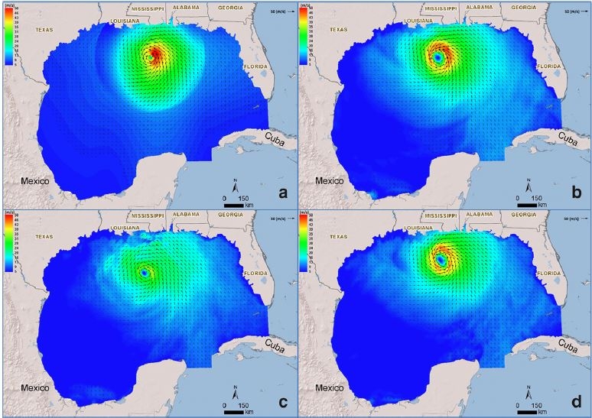
Storm Surge Modeling Tested with an Ensemble of Tropical Cyclone Simulations
Objective
Determine the feasibility of modeling storm surge using regional simulations of hurricane winds and pressure
Approach
Perform an ensemble of regional simulations of Hurricane Katrina using different combinations of parameterizations of convection and cloud microphysics
Simulate storm surge using a storm surge model driven by observed and simulated hurricane winds and pressure
Evaluate the simulated the storm surge using high-water marks from FEMA for the northern Gulf coast
Large differences in hurricane Katrina wind fields simulated by a regional model with different physical parameteri-zations
Impact
Demonstrated that skillful simulations of Hurricane Katrina can be achieved to provide forcing to a storm surge model for realistic simulations of high-water marks in northern Gulf of Mexico after Hurricane Katrina
Reducing uncertainty in modeling tropical cyclones may advance more skillful prediction of storm surge, with important implications to our ability to evaluate the risk of coastal inundation in a warming climate
Yang Z, S Taraphdar, T Wang, LR Leung, and M Grear. 2016. “Uncertainty and Feasibility of Dynamical Downscaling for Modeling Tropical Cyclones for Storm Surge Simulation.” Natural Hazards. DOI: 10.1007/s11069-016-2482-y
Notes:
http://www.pnnl.gov/science/highlights/highlights.asp?division=749

