Slide 1
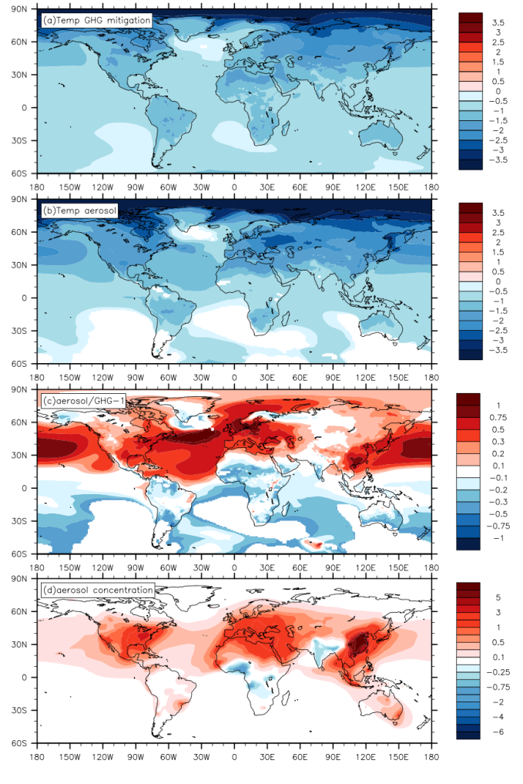
The importance of aerosol scenarios in projections of future heat extremes
(a) Normalized temperature reduction (°C/°C) due to GHG mitigation from RCP8.5 to RCP4.5. (b) Normalized temperature reduction (°C/°C) due to fixing present-day aerosols. Both values are normalized with respect to the global mean surface temperature change as in Table 1a. The global and regional averaged values are shown in Table 2. (c) The relative role of (b) and (a) calculated as (b)/(a)-1. (d) Change in the surface mass concentration (μg/m3) of sulfate aerosols between present-day and 2060–2080 in RCP8.5, which is largely responsible for the cooling in (b)
Objective
Understanding if and how the future projection of heat extremes depends on emission scenarios of GHG and aerosols.
Approach
Using a set of climate projections from NCAR/DOE CESM1 that is under RCP 8.5 and RCP 4.5, we are able to understand the role of GHG mitigation on future heat extreme reduction.
We run an additional simulations for the 21st century which is similar to RCP 8.5, but fixing the aerosol emissions as constant. By contrasting this fixed-aerosol experiment with RCP 8.5, we are able to understand the role of aerosols on future heat extreme reduction.
Heat extreme is defined as the days exceeding the 98% percentile probability distribution.
We showed that Aerosol induced cooling and associated HE reductions are relatively stronger in the Northern Hemisphere (NH), as opposed to GHG.
Aerosols are more capable of changing HE duration in the tropics, explained by stronger dynamical changes in atmospheric circulation, despite weaker thermodynamic changes.
Impact
Our results highlight the importance of aerosol scenario assumptions in projecting future HEs at regional scales.
Also, we showed that the human exposure to heat extremes is more controlled by aerosols because of the collocation of air pollutions and human populations.
Xu, Y., J.-F. Lamarque, and B. M. Sanderson (2015), The importance of aerosol scenarios in projections of future heat extremes, Clim. Change, 1–14, doi:10.1007/s10584-015-1565-1.

