Slide 1
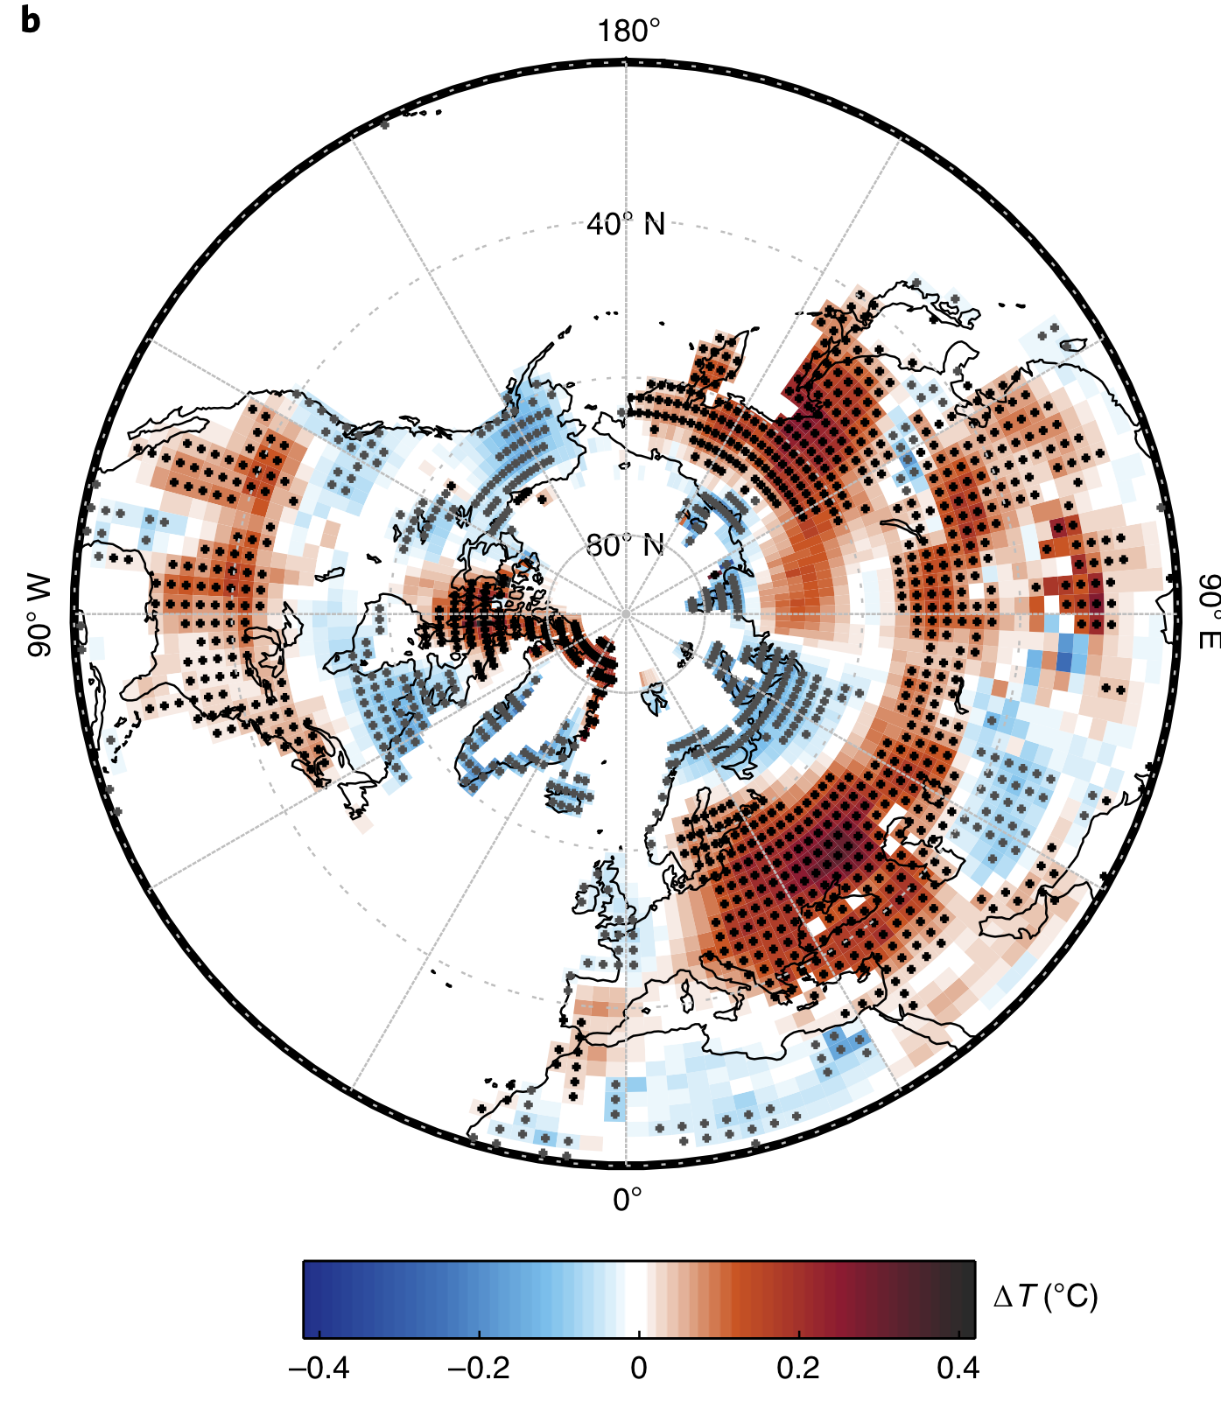

Earlier Leaf-Out Warms Air in the North
The timing of leaf growth in the spring is sensitive to climate, and has shifted earlier in recent decades. Climate model experiments show that earlier spring greenup can affect atmospheric circulation and radiative balance, and thereby further warm the climate.
We found that the extra warming due to increased water vapor and clouds in the atmosphere, which results from earlier leaf-out, is sufficiently large that it can amplify climate change.
Figure. Temperature response to imposed 12-day earlier spring leaf out throughout the northern hemisphere.
Warming due to atmospheric water vapor larger than the direct surface energy balance effects of earlier leaf greenup
Spring leaf phenology has been observed to shift, and its representation in climate models is not well constrained.
Because the warming that results from these phenological shifts is large, our results emphasize the importance of better representing phenology in climate models.
Xu, X., Riley, W. J., Koven, C. D., Jia, G., Zhang, X. (2020). Earlier leaf-out warms air in the north. Nature Climate Change, doi:10.1038/s41558-020-0713-4.

