Slide 1
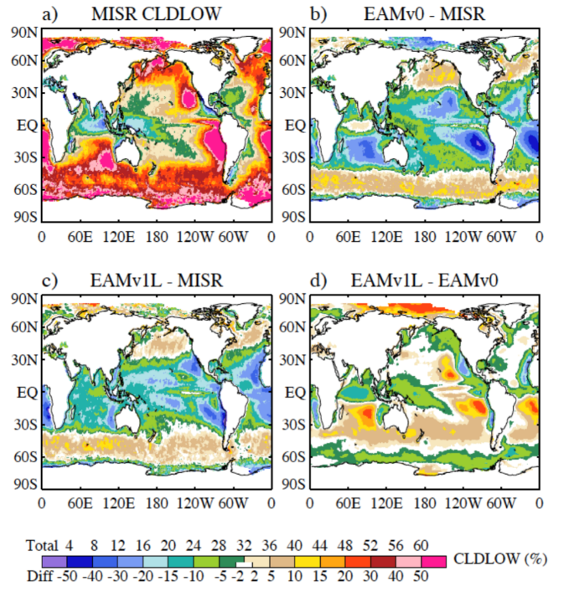


Toward Better Understanding of Cloud and Convective Characteristics Simulated in the DOE E3SM Atmosphere Model Version 1 (EAM1). Part I: Mean Climate
Objective: To document the performance of the atmosphere model in E3SMv1 (EAMv1) , with regards to clouds and cloud processes in mean climate, and contrast improvement compared to E3SMv0 (EAMv0)
Research:
--Conduct sensitivity experiments to identify source of simulation improvement seen in E3SMv1. Isolate change due to model physics, resolution, dynamical core and parameter settings.
Overall cloud (stratocumulus) improvement due primarily to introduction of 3rd order moist turbulence scheme (CLUBB)
Also improved by increased vertical resolution, but offsetting effects of tunings and horizontal resolution increases degrade the simulation. Particularly for tropical cloud forcing and precipitation in a strong ITCZ.
Annual average low cloud (%) for a) observations (MISR), b) EAM v0 bias, c) EAMv1 bias, and d) EAMv1 minus EAMv0 difference.
Impact: The processes identified for model improvements and shortcomings will inform future development activities for E3SM and provide insight in process sensitivities in models
Xie, S, W. Lin, P. J. Rasch, P. –L. Ma, P. A. Bogenschutz, J. -C. Golaz, V. E. Larson, R. B. Neale, Y. Qian, H. Wang, J.-H Yoon, 2018: Toward Better Understanding of Cloud and Convective Characteristics Simulated in the DOE E3SM Atmosphere Model Version 1 (EAM1). Part I: Mean Climate, J. Adv. Model. Earth Syst., https://doi.org/10.1029/2018MS001350

