Slide 1
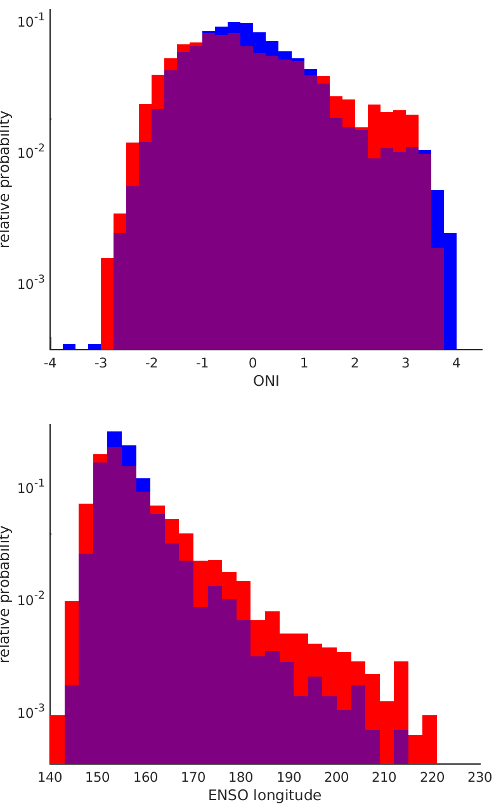

Diversity of El Niño-Southern Oscillation Events Unified by Convective Threshold Sea Surface Temperature: A Nonlinear ENSO Index
Existing index suggests the most extreme El Niño events are less frequent in a future climate
We developed a process-based El Niño-Southern Oscillation (ENSO) index that, for the first time, accounts for the nonlinear relationship between sea surface temperature and deep convection by tracking the average longitude of tropical Pacific deep convection.
The new ENSO Longitude Index (ELI) better characterizes the diversity and extremes of ENSO compared to conventional indices, and reveals that extreme El Niño, La Niña, and Modoki events increase in frequency at the expense of neutral ENSO in 21st century climate projections. ELI addresses uncertainty in ENSO event characterization by shifting the perspective from categorical to distributional event definitions. This new index will simplify model evaluation of ENSO.
New index reveals more frequent extreme El Niño events in a future climate
Relative probability of DJF (top) Oceanic Niño Index (ONI) and (bottom) ELI (°E) from the CESM-LENS historical (blue) and RCP8.5 (red) simulations, with overlap indicated by purple. Y-axis is on log-scale to illustrate changes in tails.
Williams, I.N. and Patricola, C.M. (2018), Diversity of ENSO Events Unified by Convective Threshold Sea Surface Temperature: A Nonlinear ENSO Index. Geophysical Research Letters, 45, 9236-9244. https://doi.org/10.1029/2018GL079203
We analyzed ELI in observations and simulations from the Community Earth System Model Large Ensemble Project and E3SM.
Calculation of ELI requires only monthly SST.

