Slide 1
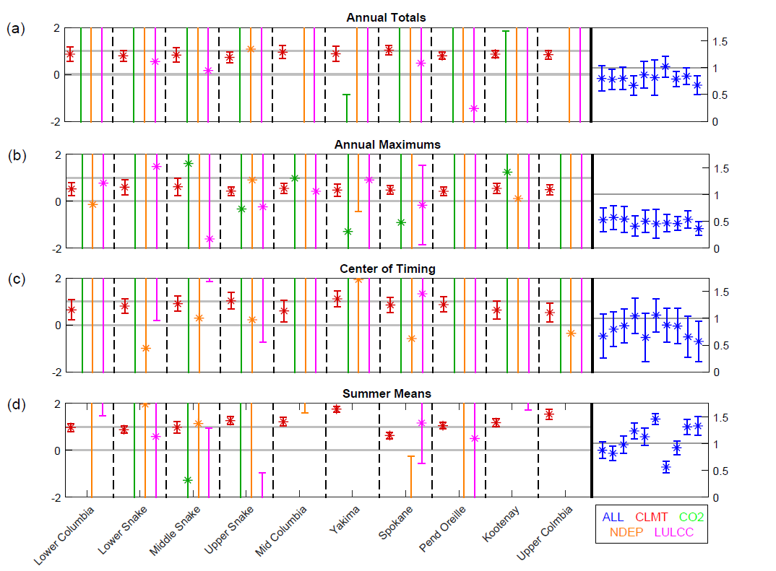

Streamflow in the Columbia River Basin: Quantifying changes over the period 1951-2008 and determining the drivers of those changes
Objective
Long-term naturalized streamflow observations and routed Energy Exascale Earth System land-surface model (ELM) runoff were used to quantify the natural and anthropogenic controls on the streamflow changes in 10 subbasins over the Columbia River Basin (CRB) for the period 1951-2008.
New Science
All subbasins showed significant declines in the observed amount of annual total streamflow, except for the Middle and Upper Snake and Upper Columbia Subbasins.
While there were significant trends induced by CO₂ concentration (CO2), nitrogen deposition (NDEP), and land use and land cover change (LULCC), their signals of change were weak in comparison to the signal in climate change (CLMT) and the natural internal variability found in streamflow.
The detection and attribution (D&A) analysis showed that the historical changes found in annual total, center of timing of, and summer mean streamflow could be attributed to changing climate and variability.
Significance
We detected the changing trends and clarified the environmental driving mechanisms for the CRB streamflow during the 1951-2008 period.
We succeeded in applying single-factor ELM simulations to conduct detailed detection and attribution analysis in order to address the causality of changes in CRB streamflow.
We assembled long-term naturalized streamflow data and developed streamflow metrics that can be incorporated into the ILAMB for future model evaluations.
A)
B)
C)
D)
Contact: Jiafu Mao (maoj@ornl.gov); Funding: BER ORNL TES SFA, RUBISCO SFA and E3SM.
Citation: Forbes, W. L., Mao, J.*, Ricciuto, D. M., Kao, S.‐C., Shi, X., Tavakoly, A. A., Mingzhou Jin*, Weidong Guo, Tianbao Zhao, Yutao Wang, Peter E. Thornton, and Forrest M. Hoffman (2019). Streamflow in the Columbia River Basin: Quantifying changes over the period 1951‐2008 and determining the drivers of those changes. Water Resources Research, 55. https://doi.org/ 10.1029/2018WR024256
Scaling Factor Estimates and Corresponding 95% Confidence Intervals for Annual Totals (a), Annual Maximums (b), Center of Timing (c), and Summer Means (d) using ALL and the Linear Combination of CLMT, CO2, NDEP, and LULCC. Scaling factors for CLMT, CO2, NDEP, and LULCC for each subbasin are shown on the left y-axis in red, green, orange, and magenta, respectively. Scaling factors for the univariate analysis using ALL (blue) are shown on the right y-axis in the same subbasin ordering. Light gray lines denote the values 0 and/or 1.

