Slide 1
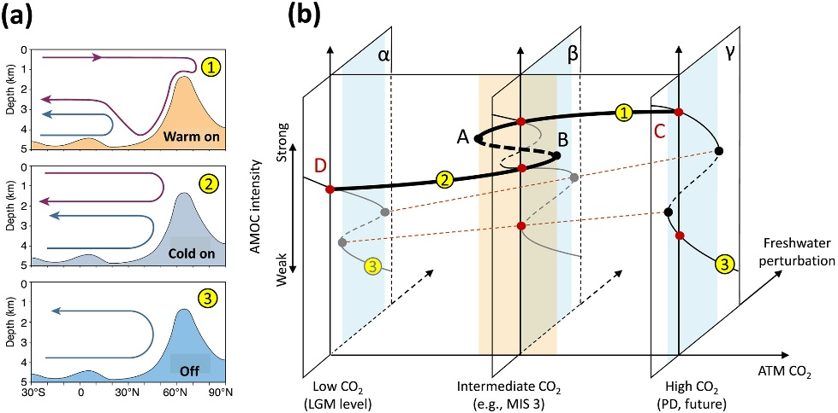
The AMOC Stability Paradigm: Review and Synthesis
Objective
Review existing literature about the AMOC stability paradigm
Present a synthesis of our current knowledge
Identify gaps in knowledge and suggest ways to address those
Synthesis diagram of AMOC stability over the glacial‐interglacial cycles. Left: three modes of the Atlantic circulation that prevailed during the last glacial period. Right: interplay between the AMOC equilibrium structure with respect to atmospheric CO₂ concentration and freshwater perturbations in the subpolar North Atlantic.
Research
Impact
The Atlantic Meridional Overturning Circulation (AMOC) redistributes significant amounts of heat, and is an important component of the climate system. Paleoclimatological studies suggest that collapses of the AMOC may have contributed to rapid climate fluctuations during the Pleistocene. Modeling studies indeed suggest that the AMOC could have two modes of operation. Here we review the literature and present a synthesis on the so-called AMOC stability paradigm.
This is the most comprehensive review of the AMOC stability paradigm to date. Our main conclusions are:
It cannot be ruled out that the current or future AMOC is in a regime of multiple equilibria
Determining the proximity of the AMOC to stability thresholds is a main research challenge
Further research is needed to identify observable metrics that distinguish between an AMOC slowdown and a collapse
Reference: Weijer, W., W. Cheng, S. S. Drijfhout, A. V. Federov, A. Hu, L. C. Jackson, W. Liu, E. L. McDonagh, J. V. Mecking, and J. Zhang (2019). Stability of the Atlantic Meridional Overturning Circulation: A review and synthesis. Journal of Geophysical Research: Oceans, 124. https://doi.org/10.1029/2019JC015083
Notes:
Wanda says that this is a general slide with no specific reference

