Slide 1
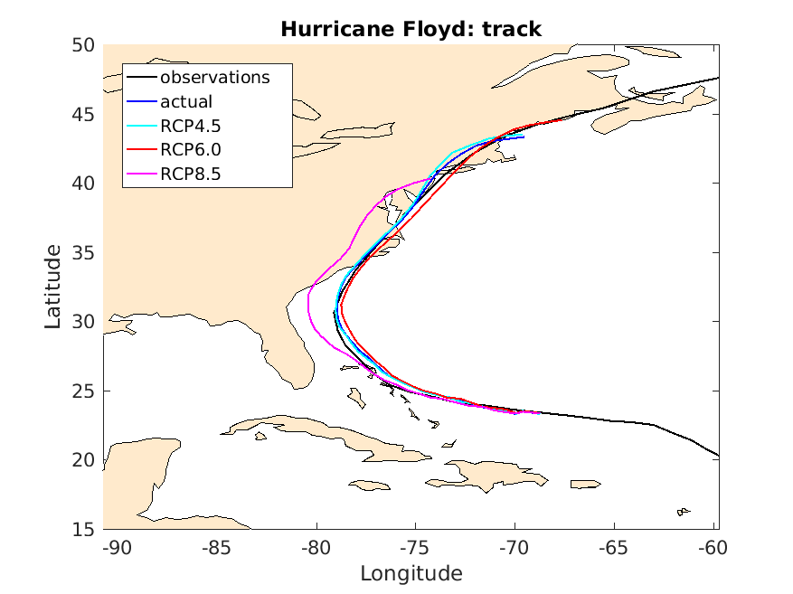
Estimating the Human Influence on Tropical Cyclone Intensity as the Climate Changes
Quantifying the human influence on individual extreme weather events is a new and rapidly developing science. Understanding the influence of climate change on tropical cyclones poses special challenges due to their intensities and scales. We present a method designed to overcome these challenges using high-resolution hindcasts of individual tropical cyclones under their actual large-scale meteorological conditions, counterfactual conditions without human influences on the climate system, and scenarios of increased climate change.
We present a hierarchy of event attribution methodologies that are designed for different purposes. The hindcast attribution method was first introduced by us in our attribution study of September 2013 floods in Colorado (Pall et al. 2017). In this book chapter, we illustrate the nuances via two studies of Typhoon Haiyan. This work forms the basis of our upcoming Nature paper examining the human influence on Katrina, Maria, Irma and 12 other storms (Patricola and Wehner 2018). It also provided the framework for our recent forecast of an anthropogenic global warming induced 50% increase in precipitation during Hurricane Florence.
The observed (black) and 10-member ensemble mean of WRF simulated Hurricane Floyd storm tracks under actual (blue) and RCP4.5 (cyan), RCP6.0 (red), and RCP8.5 (magenta) future (2080-2100) conditions. Observations are from the Revised Hurricane Database (HURDAT2, Landsea et al., 2004; Landsea and Franklin, 2013).
Michael F. Wehner, Colin Zarzycki, Christina Patricola (2018) Estimating the human influence on tropical cyclone intensity as the climate changes. To appear as book chapter in Hurricane Risk (2018), Jennifer Collins and Kevin Walsh, editors.
It is now possible to attribute the human influence on the intensity and precipitation of individual hurricanes, if any. Attribution statements are conditional, in the sense that no statement is made about cyclogenesis.

