Slide 1
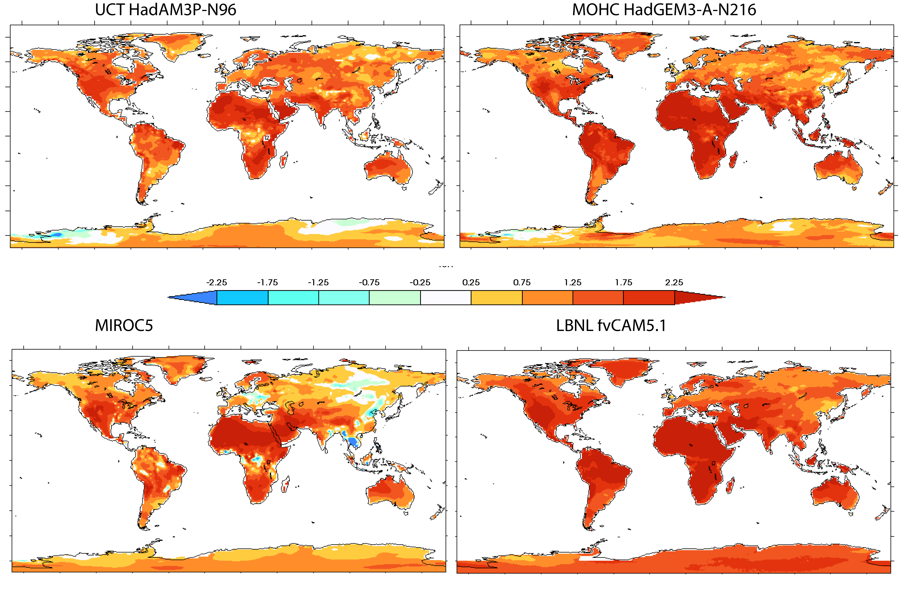
Extremely hot days in the recent past: chance or long term change?
We examine the effect of the 20th and recent 21st century changes in climate forcing on high temperature extremes as simulated by four global atmospheric general circulation models submitted to the Climate of the 20th Century Plus Detection and Attribution (C20C+) project.
We find that most regions experience increases in the frequency and intensity of extremely hot three day periods, but anthropogenic sulfate aerosol forcing can locally decrease these measures of heat waves in some models.
The natural logarithm of the Risk Ratio, ln(RR), between the actual and counterfactual C20C+ D&A simulations for the temperature values associated with the 20 year return value of the counterfactual simulations. Upper left: UCT-CSAG HadAM3P-N96. Upper right: MOHC HadGEM3-A-N216. Lower left: MIROC5. Lower right: LBNL fvCAM5.1.
A principal finding is that model treatments of atmospheric aerosols, which is not specified in the C20C+ experimental design, can have large localized influences on the magnitude and even sign of the anthropogenic change in extreme high temperature events.
Michael Wehner, Dáithí Stone, Hideo Shiogama, Piotr Wolski, Andrew Ciavarella, Nikolaos Christidis, Harinarayan Krishnan (2018) Early 21st century anthropogenic changes in extremely hot days as simulated by the C20C+ Detection and Attribution multi-model ensemble. To appear in Weather and Climate Extremes special C20C+ issue.
We analyzed daily maximum temperature output from 4 global climate models
We applied a stationary Generalized Extreme Value statistical technique.
Data are available at www.portal.nersc.gov/c20c

