Slide 1
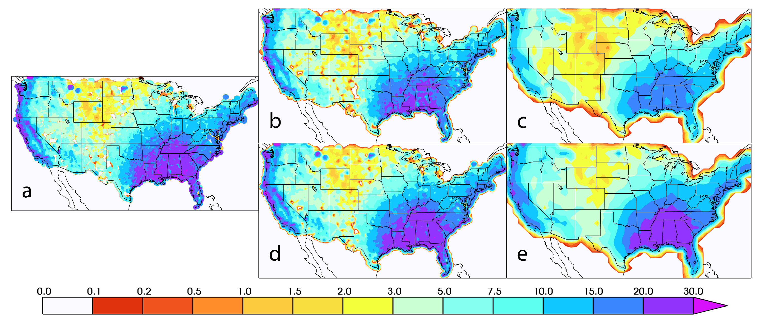

Evaluation of extreme subdaily precipitation in high-resolution global climate model simulations
We examine the resolution dependence of errors in extreme subdaily precipitation in available high-resolution climate models. We find that simulated extreme precipitation increases as horizontal resolution increases but that appropriately constructed model skill metrics do not significantly change. We find little evidence that simulated extreme winter or summer storm processes significantly improve with resolution because the model performance changes identified are consistent with expectations from scale dependence arguments alone. We also discuss the implications of these scale dependent limitations on the interpretation of simulated extreme precipitation.
Horizontal resolution in the CMIP6 HighResMIP models does not improve the simulation of subdaily extreme precipitation in the winter and summer seasons over the CONUS region nearly as much as expected. This is revealed when one considers that metrics of extreme precipitation for model evaluation must be resolution dependent. On the other hand, these resolution dependent metrics reveal that the model performance is not generally biased dry as is commonly believed.
Despite the enhanced realism of extreme storms in models at high resolution, extreme precipitation magnitudes are not greatly affected except by that predicted by resolution scaling expectations. Admittedly this is not fully understood and requires further examination.
Expected average DJF maximum 3 hour precipitation accumulation as a function of resolution and order of operations.
Michael Wehner, Jiwoo Lee, Mark Risser, Paul Ullrich, Peter Gleckler, William D. Collins (2021) Evaluation of extreme subdaily precipitation in high-resolution global climate model simulations. To appear in The Philosophical Transactions of the Royal Society. http://rsta.royalsocietypublishing.org/content/379/2195

